Slide 1

Town of Atherton
City Council Workshop
April 5, 2022
1:00 pm
Facilitators: Nancy Hetrick and Magda Gonzalez

Slide 2
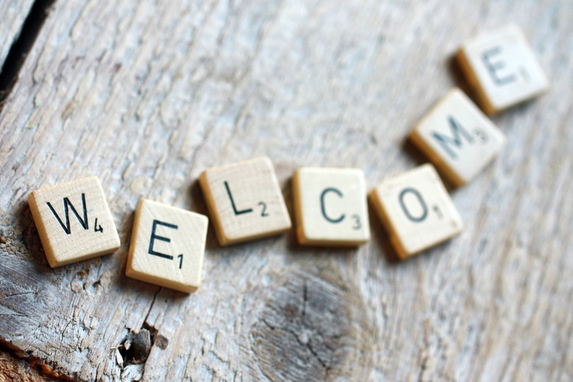

Slide 3
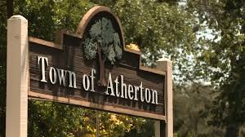
Workshop Objectives
Recognize accomplishments
Strengthen teamwork and governance
Get consensus on Council priorities for the coming year
Affirm continuing items

Slide 4
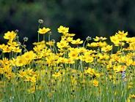
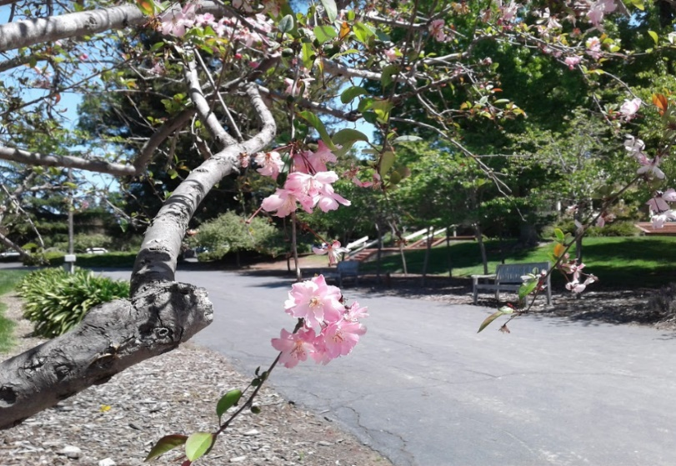
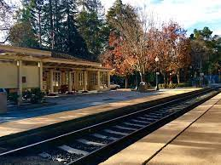

Agenda
Welcome and Agenda Review
Annual Accomplishments
Council Priorities for 2022-2023
Governing Together
Next Steps

Slide 5
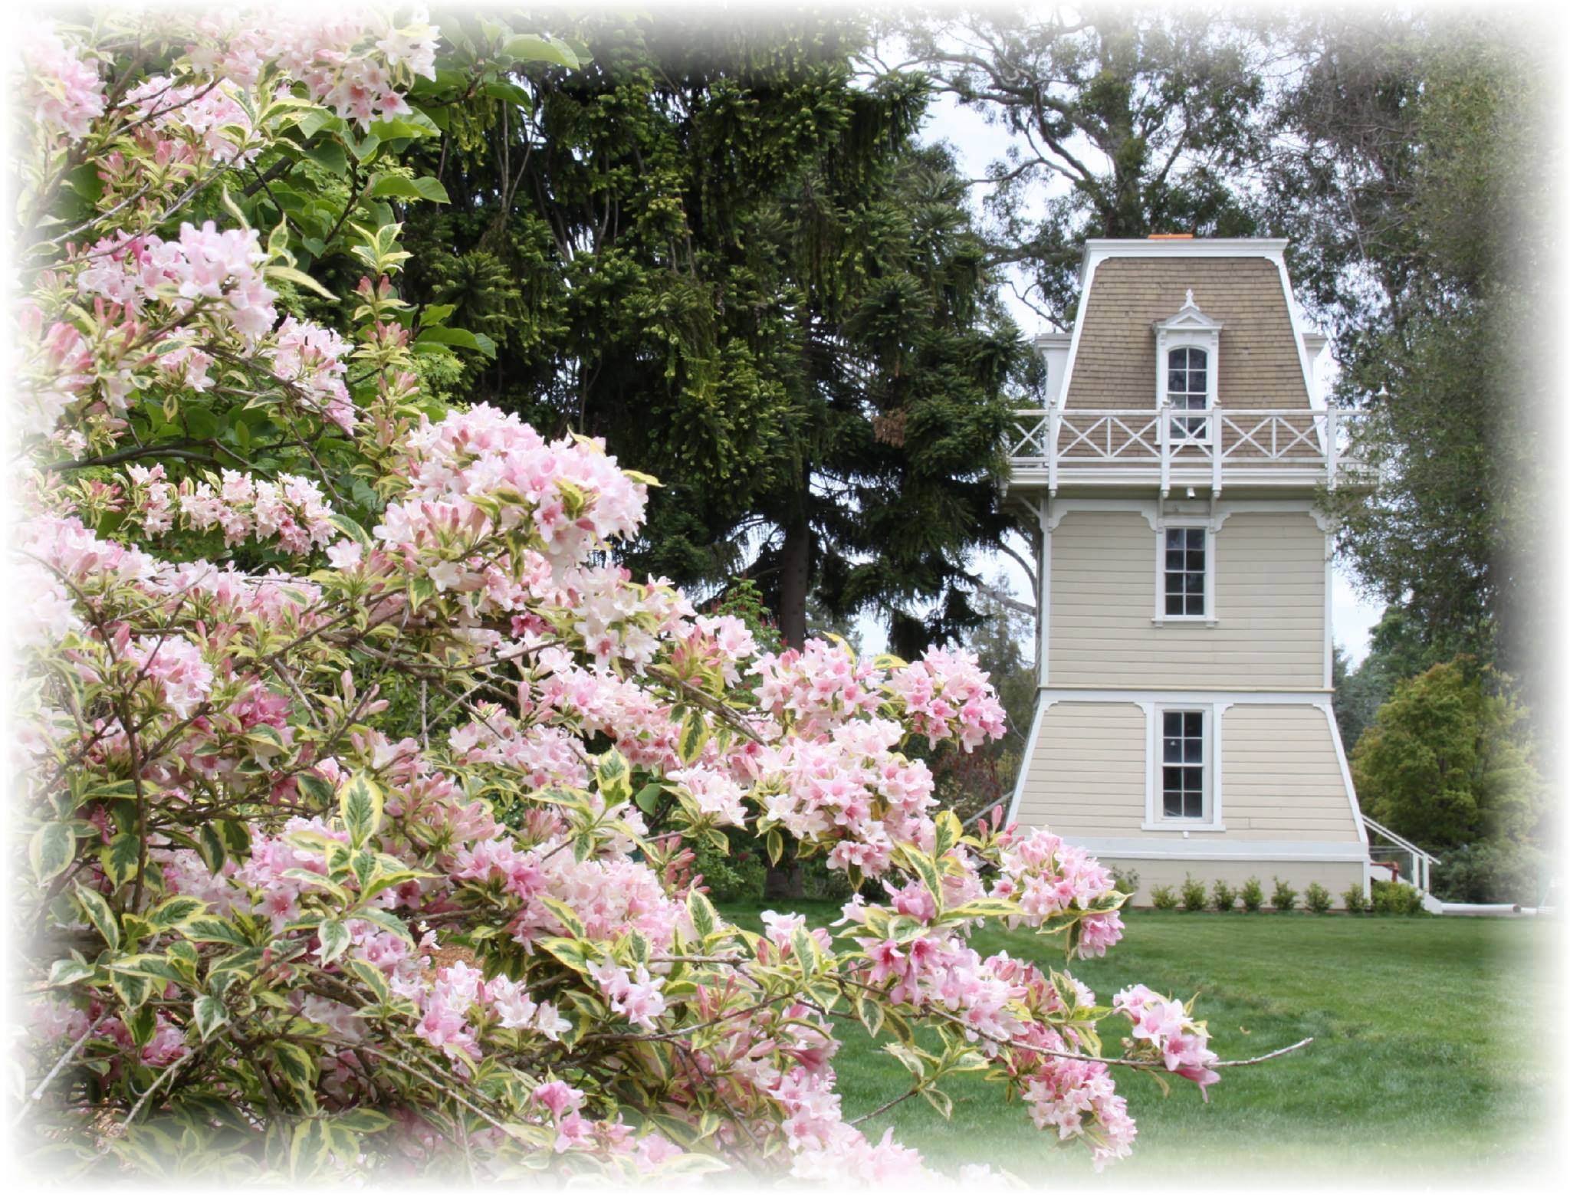
Ground Rules
Respect
Respect differences
Listen
Consensus
Seek consensus
Engage
Actively participate
Seek to understand

Slide 6
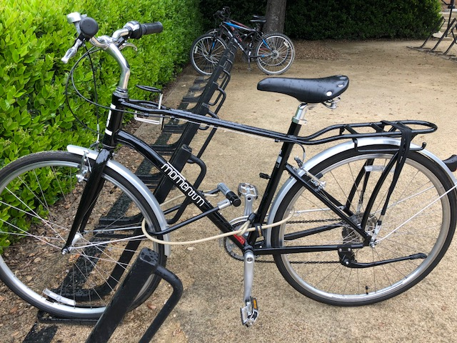
Bike Rack
Time management tool
Things to discuss at another time will be tracked separately

Slide 7
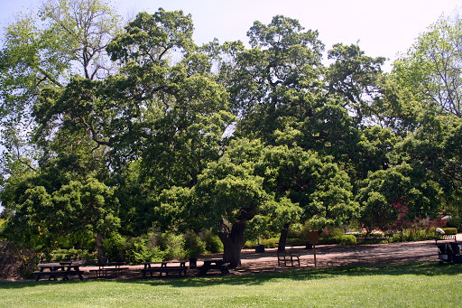
Ice Breaker
Three words to describe an effective council member

Slide 8
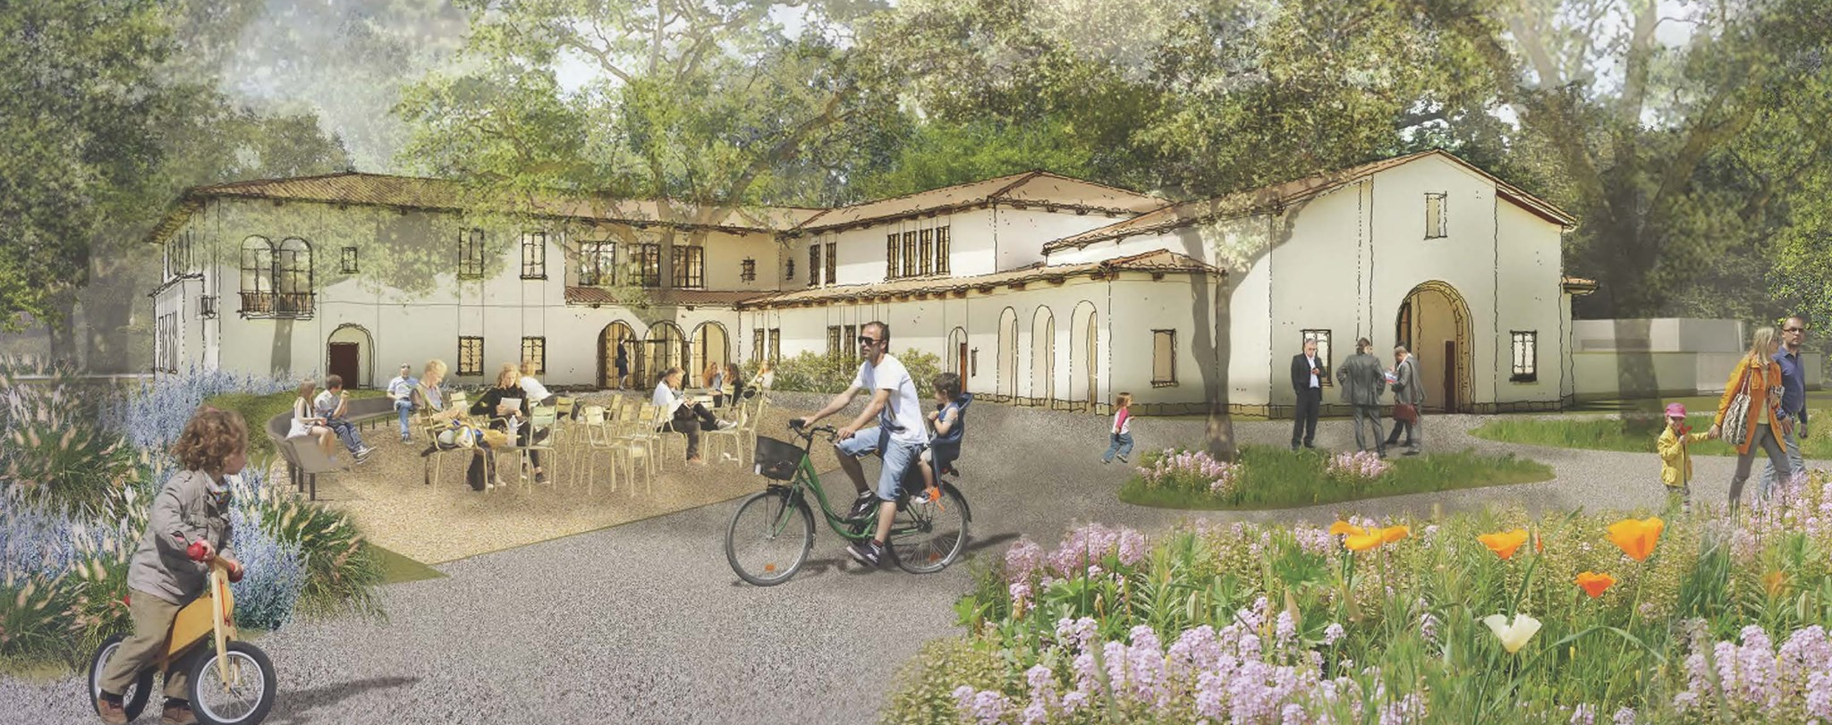
Review of Accomplishments
Notes:
City Manager provides brief update on priorities from last year. Notes ongoing items. Describes the operating environment anomalies of the past year.
Ask what they are most proud of and what contributed to the successful outcomes.

Slide 9

Town Goals and Priorities

Slide 10
Existing Council Goals
Goal A: Maintain Fiscal Responsibility – Maintain a balanced budget with adequate reserves; increase and maintain transparency
Goal B: Preserve Small Town Character and Quality of Life – Maintain focus to identify initiatives to mitigate impacts of regional growth
Goal C: Create a Town Center/Library – Ensure development of Town Center/Library is informed by outreach
Goal D: Manage Circulation and Improve Safety – Provide stewardship and leadership to maintain mobility and improve accessibility and safety for bicycles and pedestrians
Goal E: Strengthen Community Engagement and Transparency – Pursue opportunities for increased engagement and public outreach
Goal F: Be a Forward-Thinking, Well-Managed, Well-Planned City – Increase and maintain fiscal transparency
Goal G: Emergency Preparedness – Be Prepared – Partner with key stakeholders and empower residents to prepare for major emergencies

Slide 11
Priorities Identified During Interviews
Complete Civic Center; Plan for opening and public uses
Pay off/refinance debt
Address pension and OPEB planning
Public Safety (address burglaries; ADAPT program)
Traffic mitigation
Bike/Pedestrian Master Plan implementation
Infrastructure in the Park
Housing element

Slide 12
Maintain Fiscal Responsibility
Goal A: Maintain Fiscal Responsibility – Maintain a balanced budget with adequate reserves; increase and maintain transparency.
  Continuing items
    Develop a savings plan for maintenance of future facilities
    Monitor OPEB and PERS costs
    Pay off/refinance debts

Slide 13
Preserve Small Town Character and Quality of Life
Goal B: Preserve Small Town Character and Quality of Life – Maintain focus to identify initiatives to mitigate impacts of regional growth
  Continuing Items
    Maintain a proactive Police Department with strong focus on traffic safety and enforcement
    Implement Park Master Plan
    Update the Town’s General Plan (Housing Element)
    Stay abreast of regional projects that may impact the Town
    Implement Drainage Master Plan
    Leverage license plate reader technology for betterment of public safety
  New Items
    Monitor SB 9 – the California HOME Act C
    Complete Housing Element

Slide 14
Create a Town Center/Library
Goal C: Create a Town Center/Library – Ensure development of Town Center/Library is informed by outreach
  Continuing Items
    Complete the Town Center
    Plan for Town Center opening
    Determine public uses of Town Center
    Identify expenditure priorities for library funds
  New items
    Transition From ”Create Town Center/Library” to ”Develop and Implement Use Plan for the Town Center”
    Renovate the historic train station to become train museum

Slide 15
Manage Circulation and Improve Safety
Goal D: Manage Circulation and Improve Safety – Provide stewardship and leadership to maintain mobility and improve accessibility and safety for bicycles and pedestrians
  Continuing Items
    Implement Bike/Pedestrian Master Plan
    Improve safety of Caltrain crossings
    Implement traffic mitigation measures

Slide 16
Strengthen Community Engagement and Transparency
Goal E: Strengthen Community Engagement and Transparency – Pursue opportunities for increased engagement and public outreach
  Continuing items
    Hold community events that celebrate community involvement
    Engage the public through meetings on a variety of topics (public safety, general plan, housing, etc.)
    Enhance use of OpenGov Transparency Portal
  New Items
    Improve data gathering and reporting on police activity
Notes:
Mention Town Center public uses priority

Slide 17
Be a Forward-Thinking, Well-Managed,
Well-Planned City
Goal F: Be a Forward-Thinking, Well-Managed, Well-Planned City – Increase and maintain fiscal transparency
  Continuing Items
    Enhance collaboration and partnerships with regional agencies
    Environmental programs (e.g., Climate Action Plan, Reach Codes)

Slide 18
Emergency Preparedness –
Be Prepared
Goal G: Emergency Preparedness – Be Prepared
Partner with stakeholders and empower residents to prepare for major emergencies
  Continuing Items
    Expand support for ADAPT
    Ensure reliable emergency communication systems
    Identify and engage the community in emergency communications

Slide 19
Discussion
Is there anything missing?
What are your top priorities for the next year?
Notes:
Ask each council member for their top priorities.
Are these the right mix of priorities?
For each item – ask for comments and what success would look like a year from now?
Anything missing?
What are the top priorities for the coming year (ask for each Councilmember’s top priority)
Seek agreement on the top priorities (with any proposed modifications)

Slide 20

Break

Slide 21
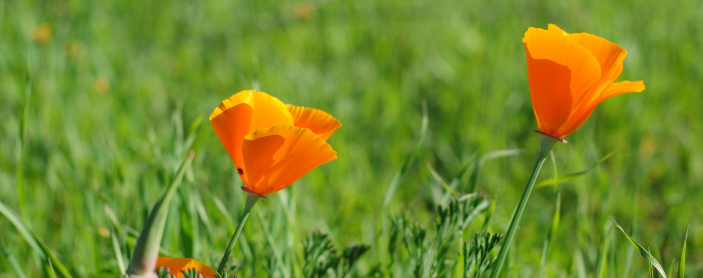
Governing Together
Notes:
What do you most enjoy about being on the City Council?
How do you define the role of a Councilmember? How do you define the role of staff?

Slide 22
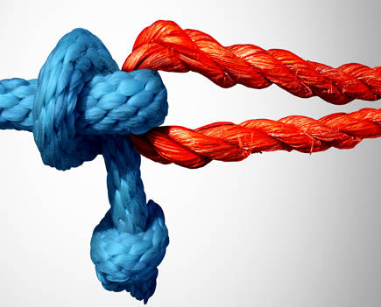
Governance is a Team Sport
It requires:
Effective leadership by the Mayor and Council
Responsive management and leadership by the City Manager
Meaningful communication that is honest, direct, respectful, proactive
Understanding roles and fulfilling expectations
Fostering mutual respect and building trust
Ethics
This Photo by Unknown Author is licensed under CC BY-SA-NC
Notes:
Refresher…
Refer to ILG Article – what stands out to you as either valuable or desired?

Slide 23
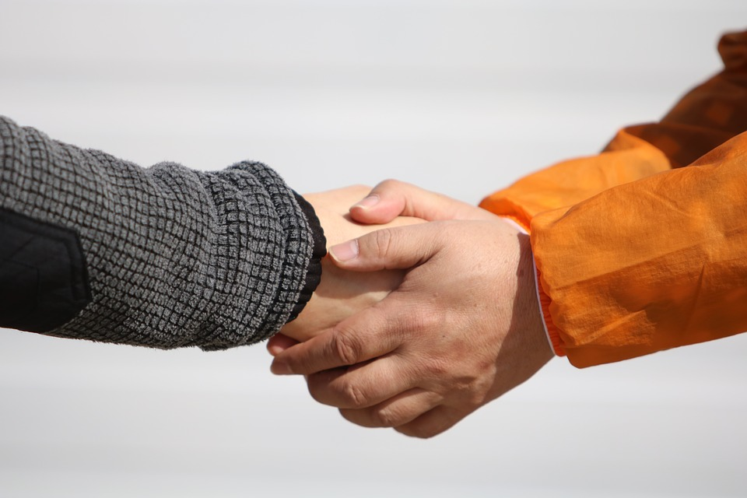
Attributes of High Performing Councils
Commit to true partnerships among Councilmembers, City Manager and staff
Exhibit clarity and respect for roles and responsibilities
Demonstrate civility and respect for all
Conduct effective meetings
Hold themselves and the City Manager accountable
Practice continuous learning

Slide 24
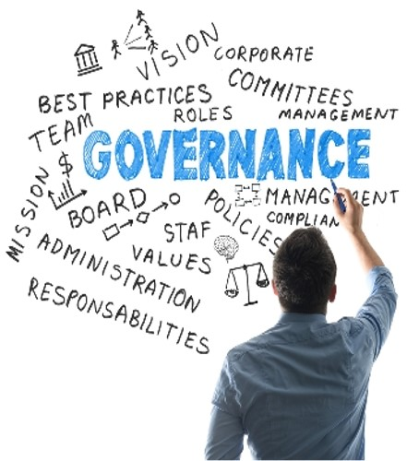
Getting the Most Out of the Team
What do you need from the City Manager?
And what does the City Manager need from you?

Slide 25

Working Together – Council Norms
Notes:
Using norms as a best practice for setting Council up for success.

Slide 26
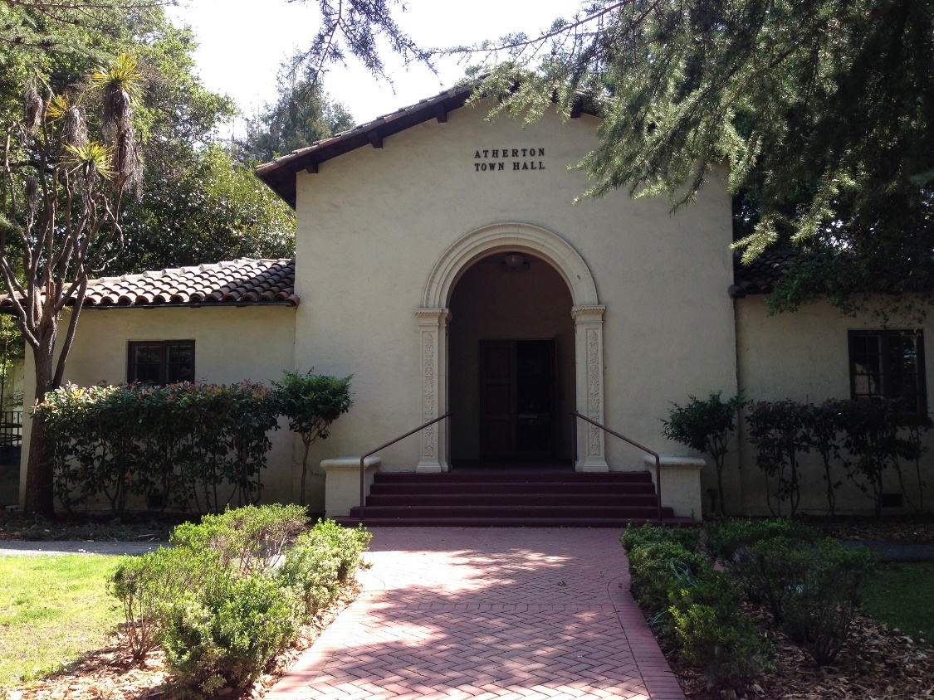
Atherton Council Norms (updated 2021)
Assume good intent
Show mutual respect
Be trustworthy
Listen with intention; strive to make others feel heard
Seek clarification with both staff and colleagues
Focus on the issue, not the person
Disagree agreeably and maintain decorum at the dais
When debate is over and vote is taken, we move on
Envision the future and make progress on long-term goals
Inspire public confidence in our city government
Notes:
Behavioral Norms

Slide 27
Procedural Norms
What procedures or general practices work well?
What gets in the way of effective meetings?
Notes:
As we shift from a Pandemic world back to in-person meetings, let’s take the opportunity to review meeting procedures and governance best practices.
ASK: What procedures or general practices work well; what gets in the way of effective meetings?
Get agreement on procedural norms that can be embraced by Council

Slide 28
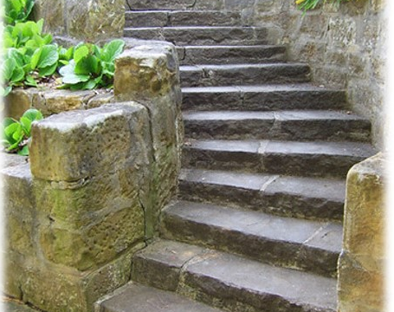
Next Steps
Notes:
Review any action items and next steps
Note that MP will send out a summary report of the session.

Slide 29

Reflections on Today’s Workshop
Notes:
Ask for closing comments

Slide 30
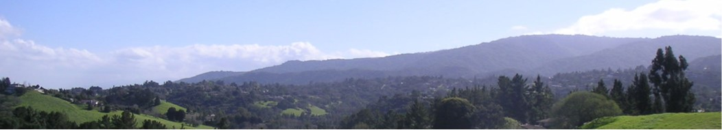
Thank you
Facilitator Contact Information
Nancy Hetrick| nhetrick@managementpartners.com
Magda Gonzalez | mgonzalez@managementpartners.com

