Slide 1
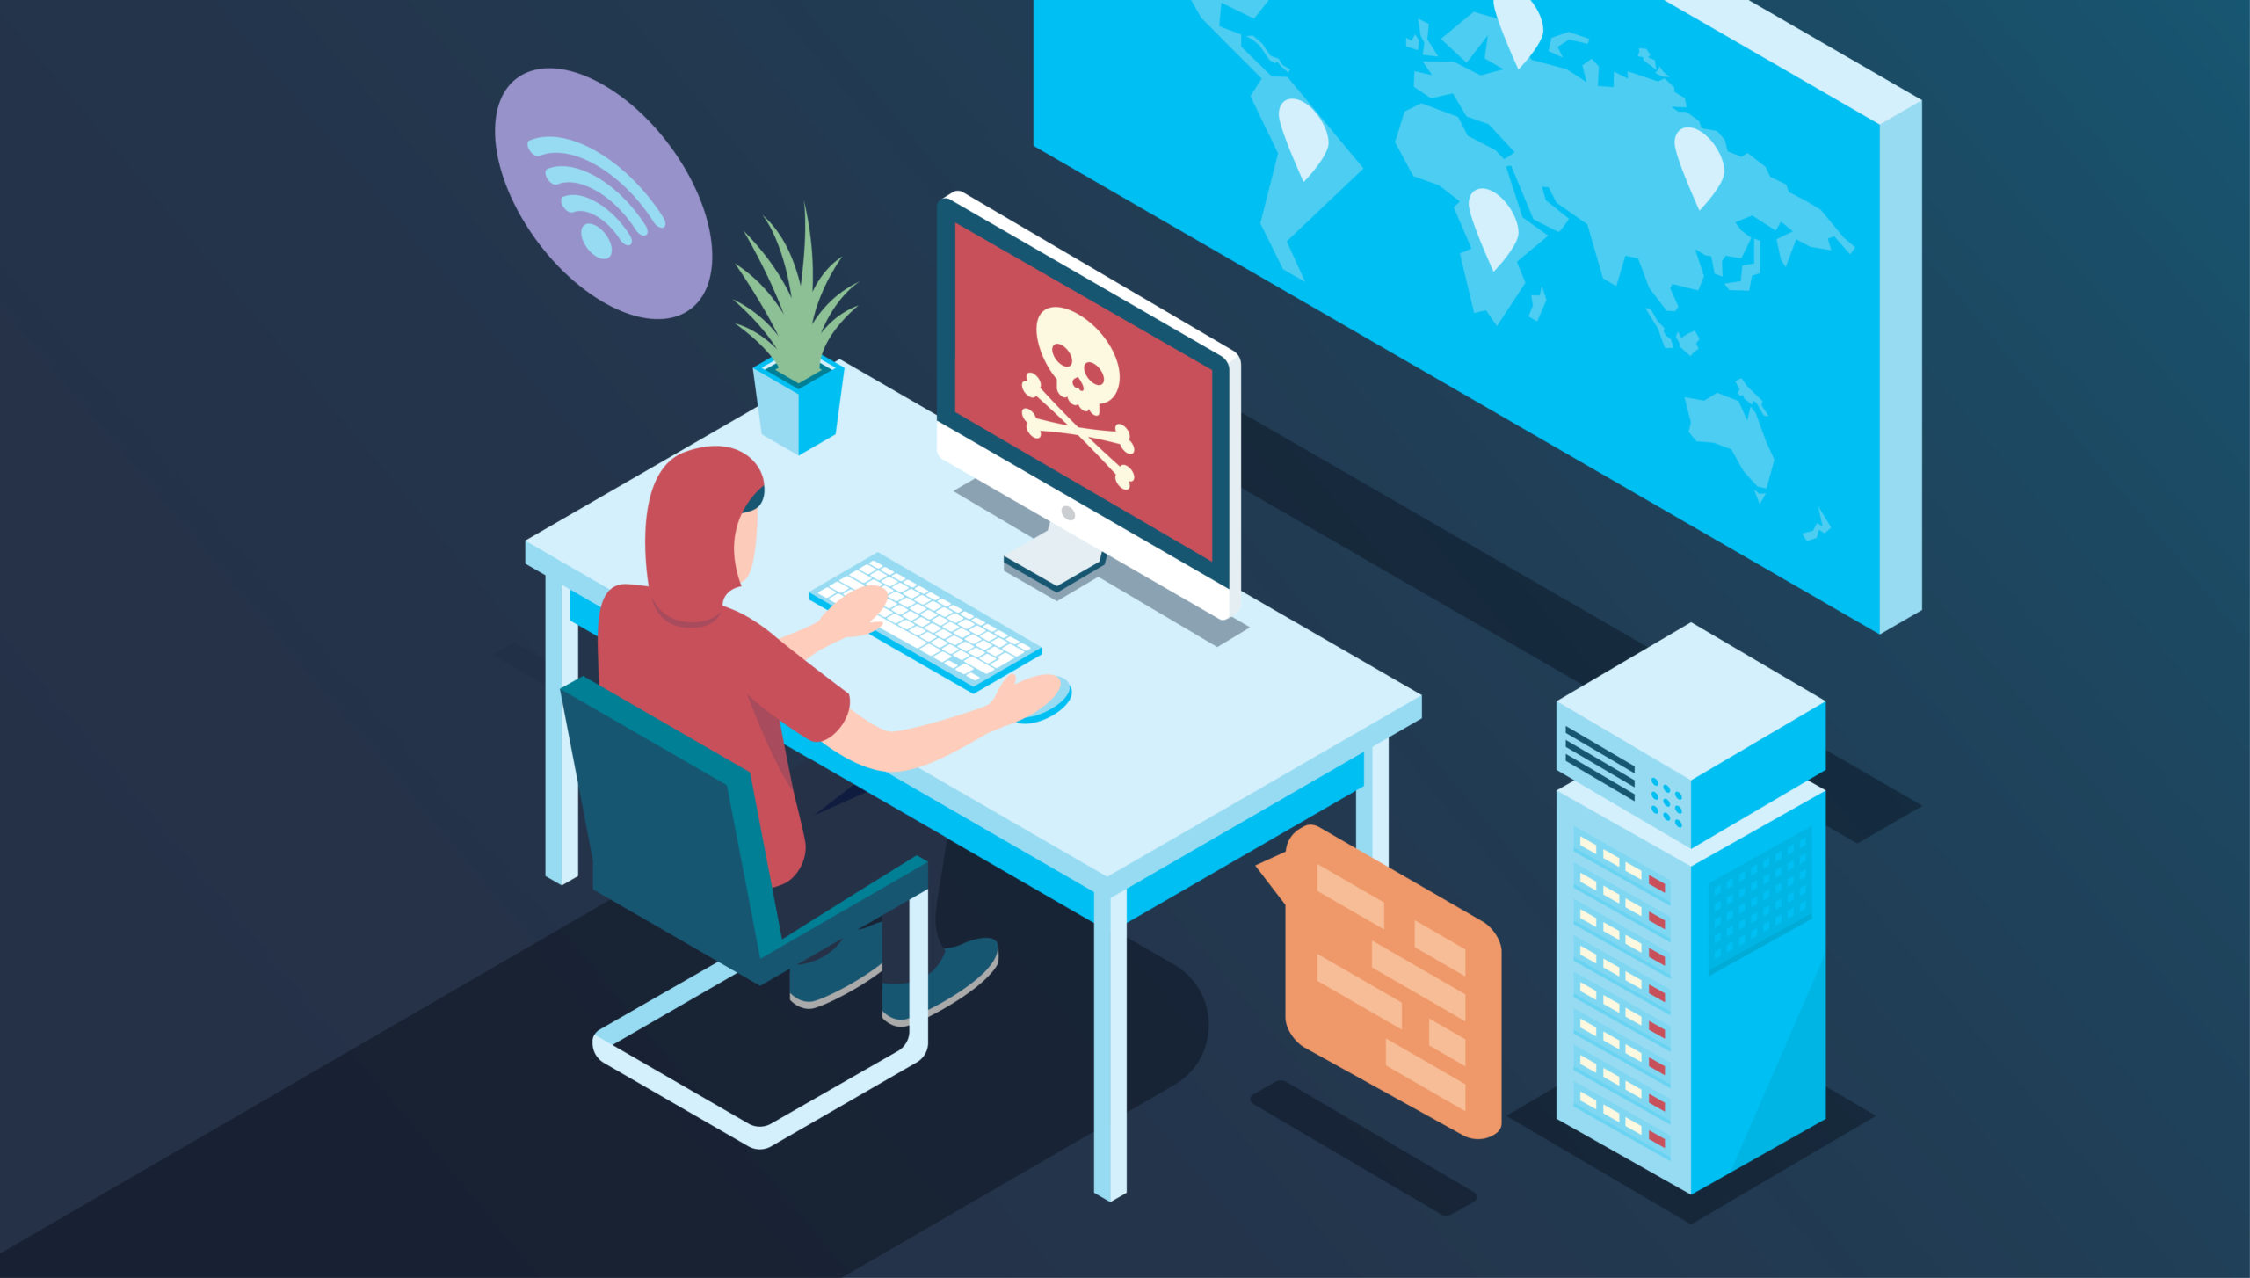
Cyber Security Presentation (Anti-Malware/Phishing)

Slide 2
Topics for Discussion
Importance of Awareness
Attack Surface
Phishing
Common Examples
Spear Phishing
Recognition
Prevention
Ransomware
Social Engineering
Other Safety Tips

Slide 3

Importance of Awareness: You are the target…
You, and your access to City data, are the primary target of hackers.
Gaining access to your login information allows them to impersonate you, or use your computer, to gain access to city systems and data.
IT can address only a portion of security risks.
Most Commonly Compromised
End User Access
Allows Bad Actors to
Impersonate End Users
Access Files
Send/Receive email
Steal data/information

Slide 4
WHAT IS AN AttACK SURFACE?
These are all the points at which a malicious threat actor could try to exploit a vulnerability.
Direct access – Physical or local attack
Removable media
Email
Remote and wireless
Supply chain
Web and social media
Cloud

Slide 5
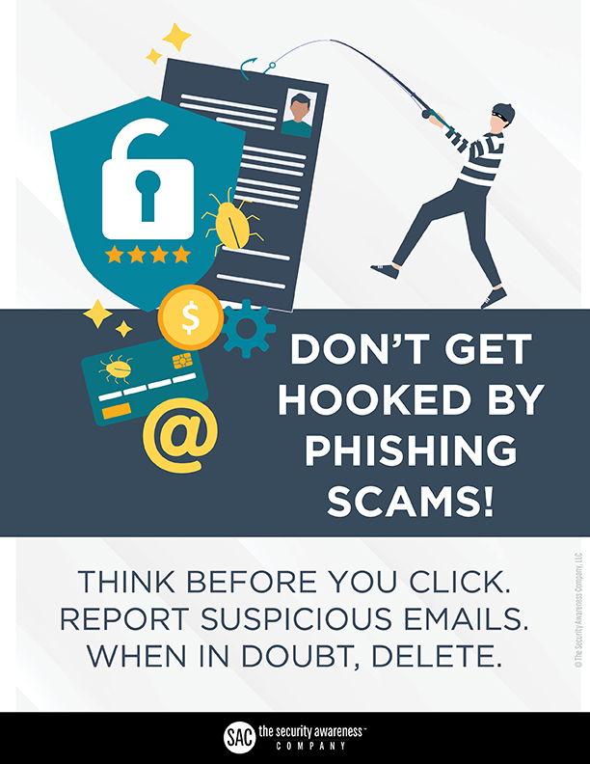
Phishing: What is it?
Phishing – Cybercriminal attempts to steal personal and financial information or infect computers and other devices with malware and viruses
Designed to trick you into clicking a link or providing personal or financial information
Often in the form of emails and websites
May appear to come from legitimate companies, organizations or known individuals
Take advantage of natural disasters, epidemics, health scares, political elections or timely events

Slide 6
Common Baiting Tactics
Notification from a help desk or system administrator Asks you to take action to resolve an issue with your account (e.g., email account has reached its storage limit), which often includes clicking on a link and providing requested information.
Advertisement for immediate weight loss, hair growth or fitness prowess Serves as a ploy to get you to click on a link that will infect your computer or mobile device with malware or viruses.
Attachment labeled “invoice” or “shipping order” Contains malware that can infect your computer or mobile device if opened. May contain what is known as “ransomware,” a type of malware that will delete all files unless you pay a specified sum of money.
Notification from what appears to be a credit card company Indicates someone has made an unauthorized transaction on your account. If you click the link to log in to verify the transaction, your username and password are collected by the scammer.
Fake account on a social media site Mimics a legitimate person, business or organization. May also appear in the form of an online game, quiz or survey designed to collect information from your account.

Slide 7
Hidden Threats
Phishing not only attempts to get sensitive info
Can include malicious software
Attachments, Emails, Links, Files
May Contain Programs that:
Capture your keystrokes
Capture your personal files
Send data offsite
Encrypts data and requests a ransom

Slide 8
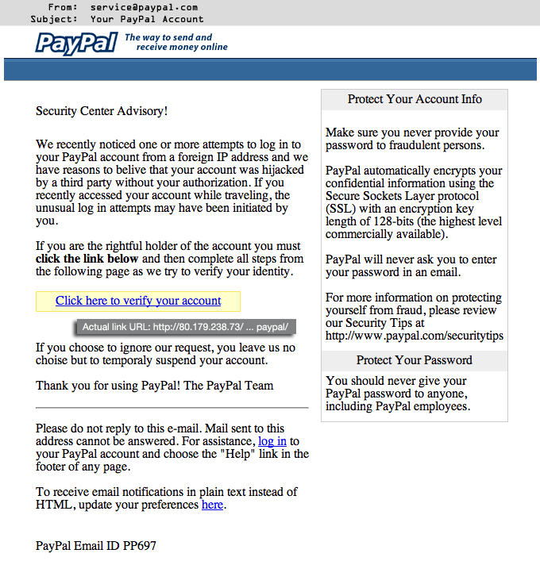
Common Examples
Phishing is not new and many of you have seen examples in emails
You may have seen emails that appear to come from your bank or other online financial institutions.
Commonly Seen Commercial Examples:
eBay, PayPal, all banking and financial institutions

Slide 9
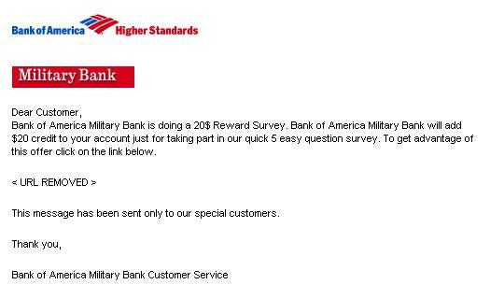
Common Examples
Phishing Email sent portraying Bank of America, Entices the user to complete a survey and receive a $20 credit.

Slide 10
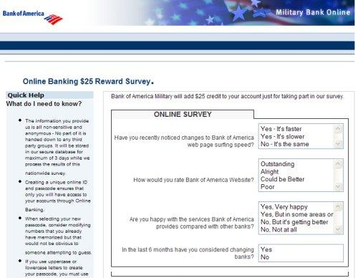
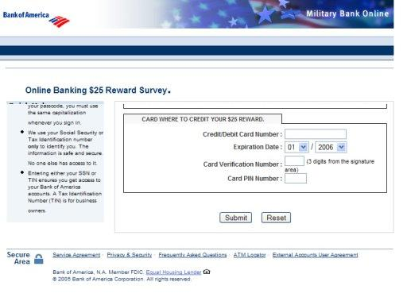
Common Examples
Convincing website linked from BOA email

Slide 11
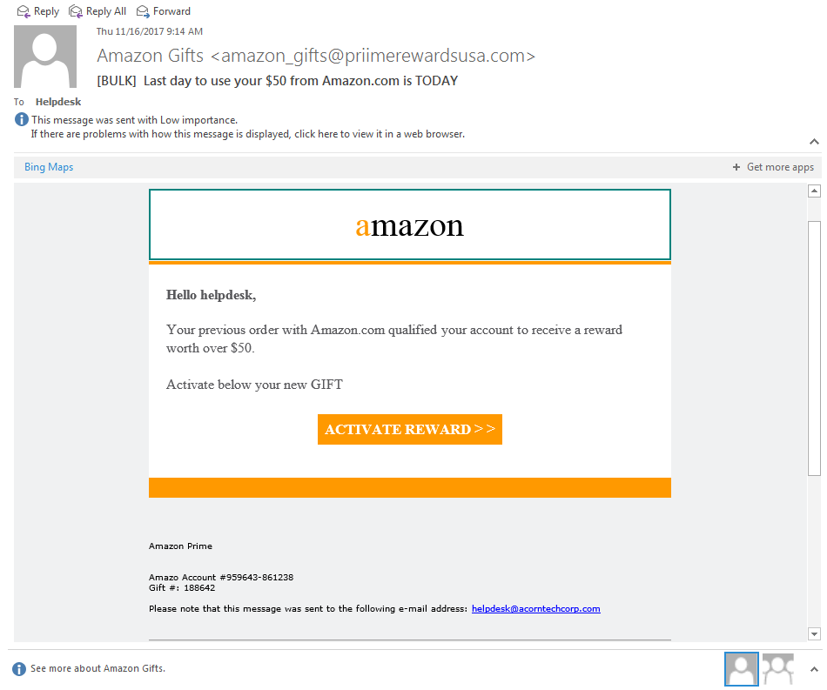
Common Examples

Slide 12
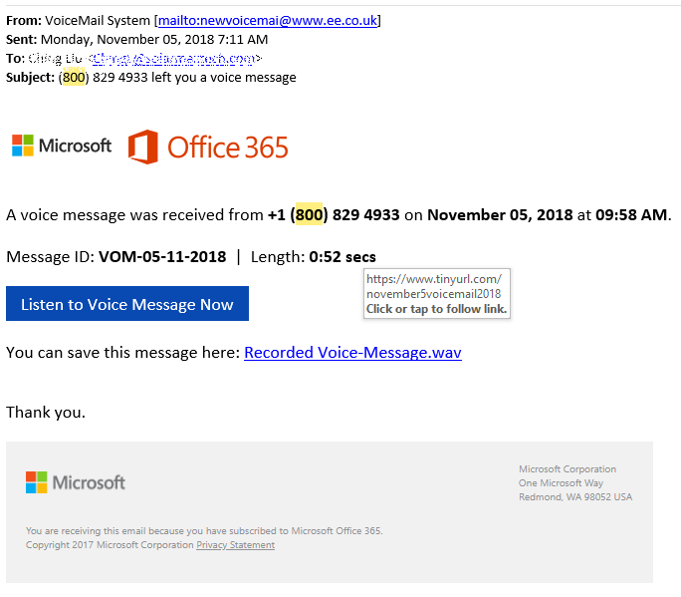
Common Examples

Slide 13
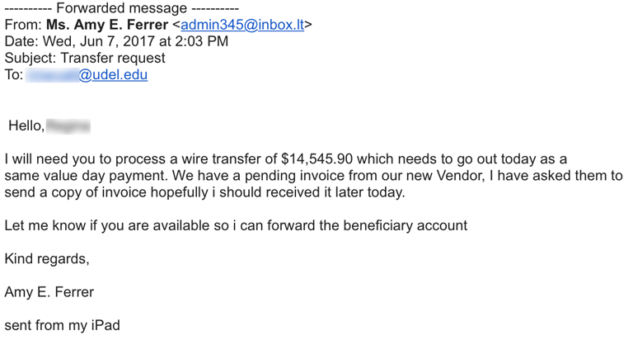
Spear Phishing Example
Targeted plausible payment request. DO NOT SEND MONEY BEFORE CONFIRMING WITH SENDER

Slide 14
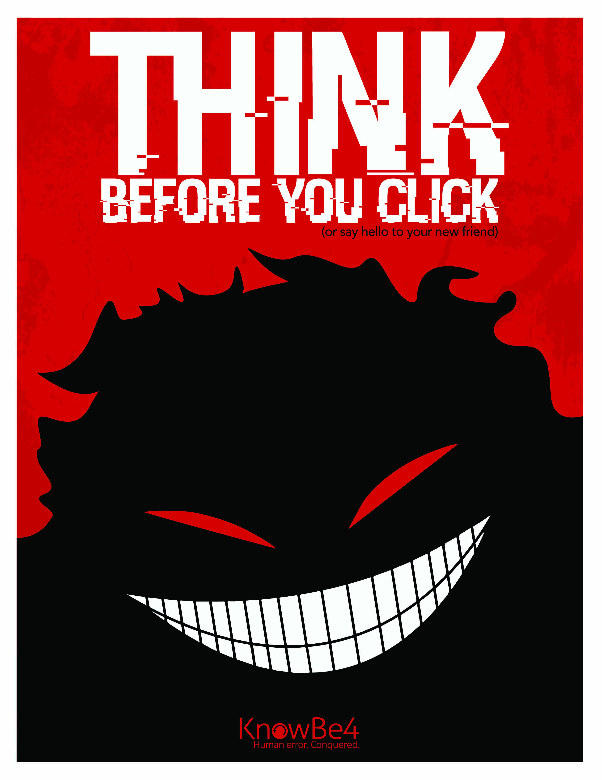
Should I be worried?
Occurs in organizations everyday
Attacker’s primary focus is to get you to:
Open an attachment
Follow a web link
Install the malicious software
If you receive an email that is out of the ordinary or unexpected:
Always confirm with the sender
Even if you are familiar with them
Their account may be compromised

Slide 15
Recognition
Other recognition factors of phishing attempts:
Generic Greeting
Fake Sender’s Address
False Sense of Urgency
Fake and deceptive web links
Requires you follow a link
Requires you to “sign up” for a great deal
Requires you to log in and verify your account
Encourages you to view/read an attachment
Emails that appear like a website
Misspellings and bad grammar

Slide 16
Recognition
“From” field of an email can be easily faked (spoofed).
It might appear completely correct or have a similar variation.
account_security@mypay.com
On the other hand, the message may come from a:
legitimate email account, because that account has been compromised.
john.smith.yourboss@yourbusiness.com
This can occur when the attackers obtain someone’s login credentials and email contacts in their address book in order to obtain more accounts.

Slide 17
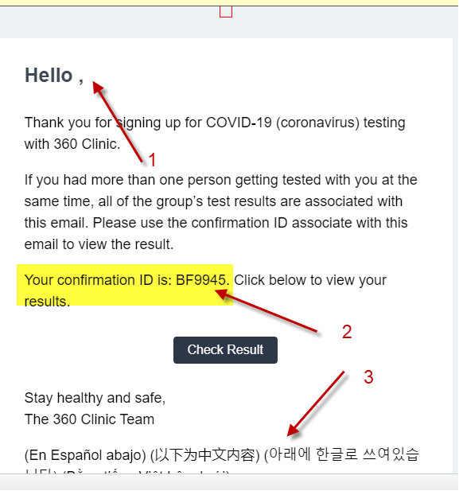
Recognition (Example 1) COVID-19
Here is an example of a phishing attempt using COVID-19 as an attention grab. If you were not expecting a confirmation or anything similar, please delete and let IT Services know about the suspicious email.
1. Generic Hello used and name missing in the field.
2. Confirmation ID shown when you’re not expecting one.
3. Several foreign languages shown in the same email, meaning this was a mass email spread. (Usually senders will give you an option to view a foreign language in a separate page).
4. A link to, “Check Results”
1617

Slide 18
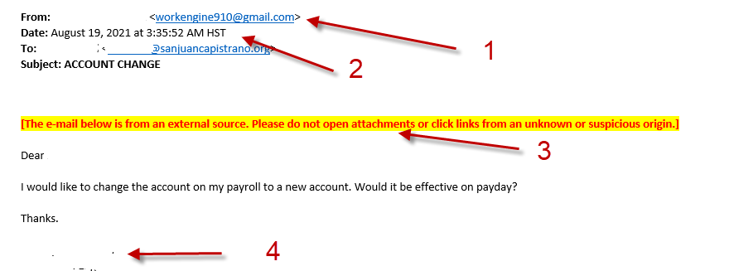
Example 2
Here is an example of a phishing email. (Name fields were redacted).
1. From an odd/generic/outside email address.
2. Time stamp was early in the morning.
3. The highlighted message flagging that is an external email and not Internal.
4. Generic or basic signature. (If you don’t have a city signature on your emails, please contact IT to assist with setting up a signature).

Slide 19
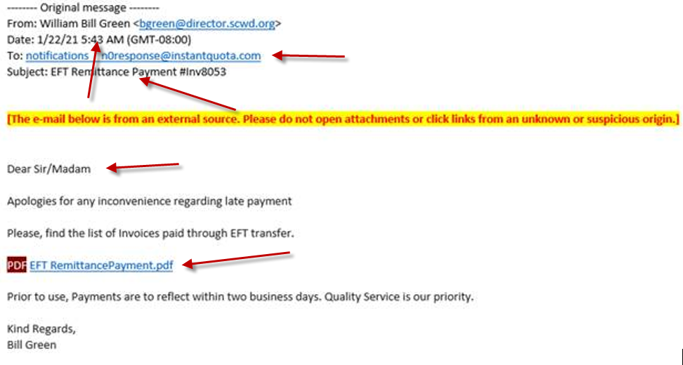
Example 3
“To” Filed is not your email address
Odd hours for an email
Subject title to catch your eye
Dear Sir/Madam – Generic Greeting
PDF download option to directly download a payload virus

Slide 20
Protect Yourself: Refuse the Bait
Be cognizant and vigilant of this threat.
1
Before clicking on any web link within a message or opening up an attachment, be sure the source of the email is legitimate.
2
The links and attachments can contain:
3
Malware
Spyware
Viruses
Trojan horses
STOP. THINK.
4
Before you click, look for common baiting tactics
If the message looks suspicious or too good to be true, treat it as such

Slide 21
Don’t become phish food

Slide 22
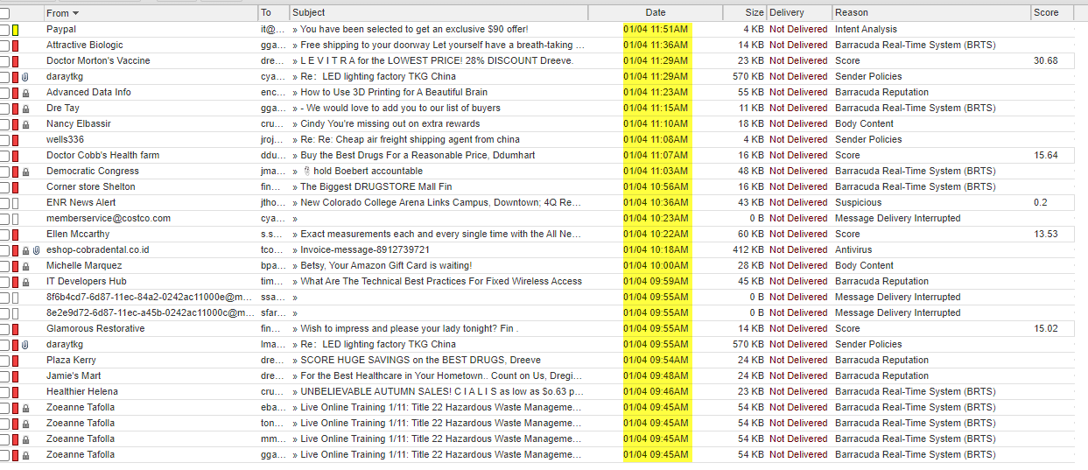
Specific Examples

Slide 23
Got Hooked?
If you suspect… | You should…
You interacted with or replied to a phishing scam using your City email account | Immediately contact the IT Help Desk:
You might have revealed or shared personal or financial information | Immediately change the password(s) for your account(s). If you use the same password for multiple accounts and sites, change it for each account. Do not reuse that password in the future. Watch for signs of identity theft by reviewing your bank and credit card statements for unauthorized charges and activity. If you notice anything unusual, immediately contact your credit card or bank. Enable 2-factor authentication

Slide 24
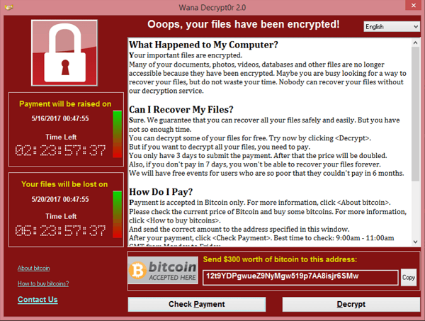
Ransomware
Ransomware is a newer type of malware that encrypts documents, pictures and other files, making them unreadable. The attacker then holds the decryption key for ransom until you agree to pay money, usually through an untraceable method such as BitCoin or other digital currency.
Ransomware assumes that you’ll pay to recover your files – if you back them up regularly, you have no need to pay the ransom, (assuming your backups are secure and regularly checked).

Slide 25
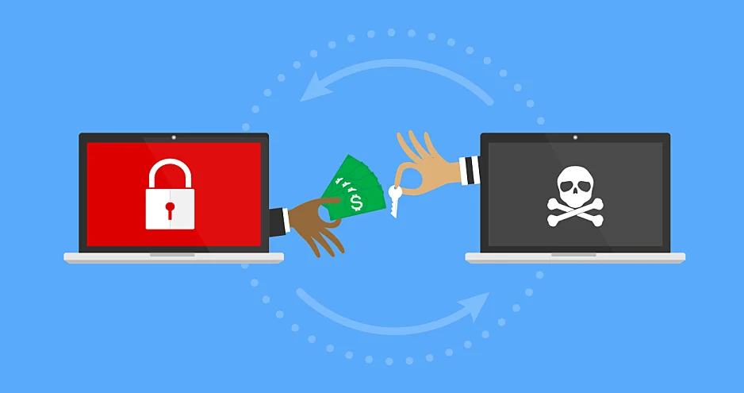
Encryption: A Key Component of Ransomware
Ransomware has been continuously evolving in the past few years, in part due to the huge revenue stream, lack of cyber security, lack of IT Support funding, and lack of patch management (updates/upgrades).
Ransomware is here to stay.

Slide 26
Ransomware on the Rise
Bitcoin has been a significant factor in the rise in ransomware attacks. The lack of oversight by any governing body coupled with anonymity makes it an ideal currency in ransomware demands.
The evolution of ransomware-as-a-service (RaaS) has also played a significant role in the proliferation of attacks. RaaS has moved the execution of a ransomware attack from "professional" to "script-kiddie."

Slide 27
Recent Victims of Ransomware Attacks
2019:
Lake City, Florida
Riviera Beach, Florida
City of Baltimore
Cleveland Hopkins International Airport
Augusta, Maine
Tallahassee
Albany, New York
Jackson County
2020:
San Miguel County, NM
Florence, AL
Tillamook County, OR
La Salle County IL
University of California San Francisco (UCSF)
Communication & Power ( CPI)
Travelex

Slide 28
Continued
The Northern Territory Government in Australia was next to reveal an attack that forced its systems offline for 3 weeks.
Central Piedmont Community College in North Carolina.
Discount Car and Truck Rental, part of the Enterprise group and one of Canada’s biggest rental agencies, was hit by the Darkside ransomware gang. Darkside posted a notice on its leak site stating they had copied 120 GB of corporate, banking and franchise data from the firm.
Kia Motors America – 20 million for a decryptor
Yuba County in California
University of California
Colonial Pipeline - The company opted to pay a $5 million ransom so services could be resumed.
Azusa Police Department
& Many More
https://www.blackfog.com/the-state-of-ransomware-in-2021/

Slide 29
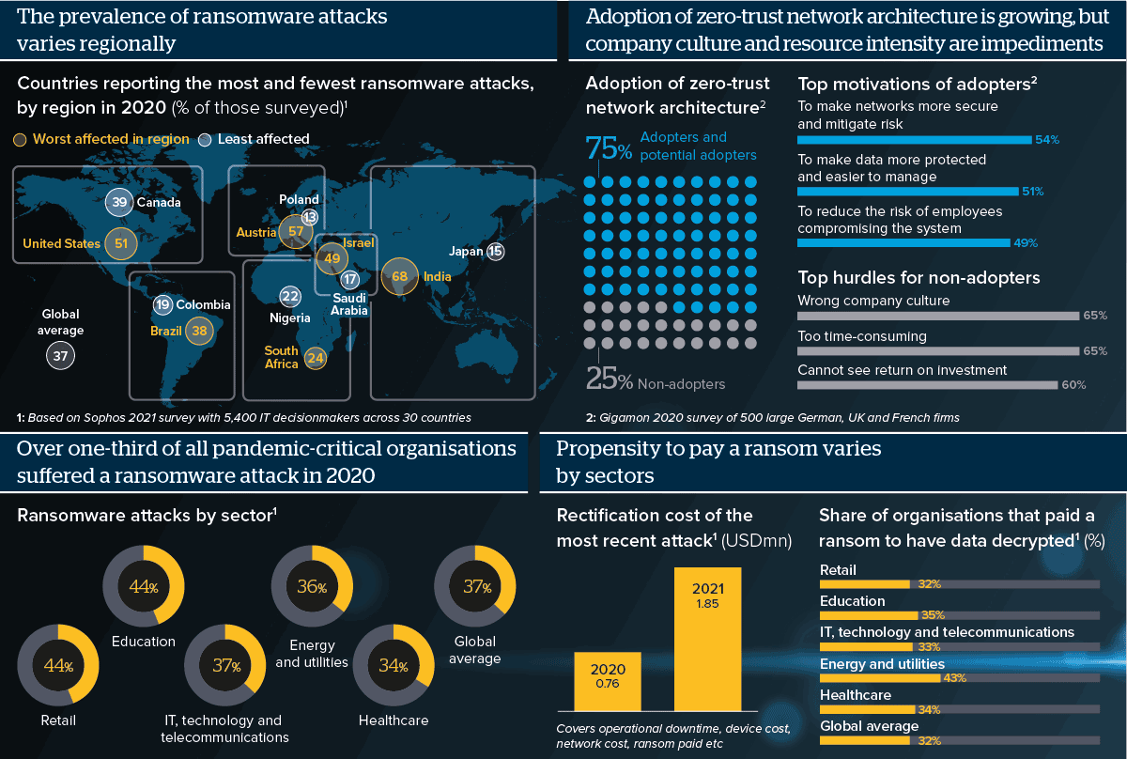

Slide 30
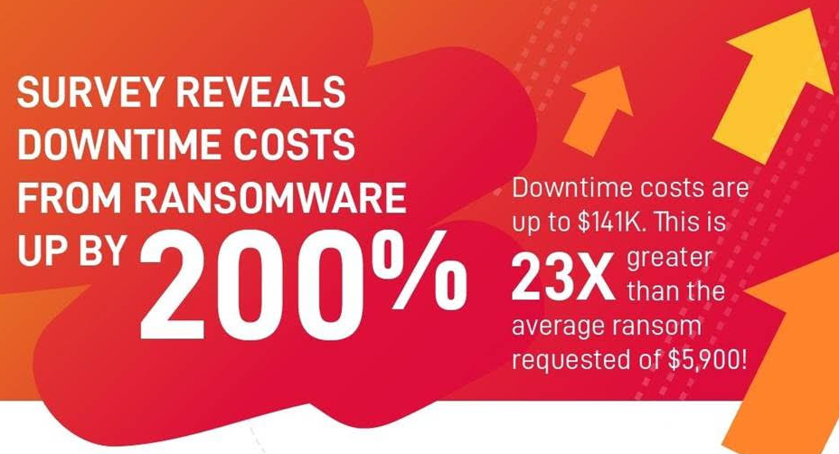

Slide 31
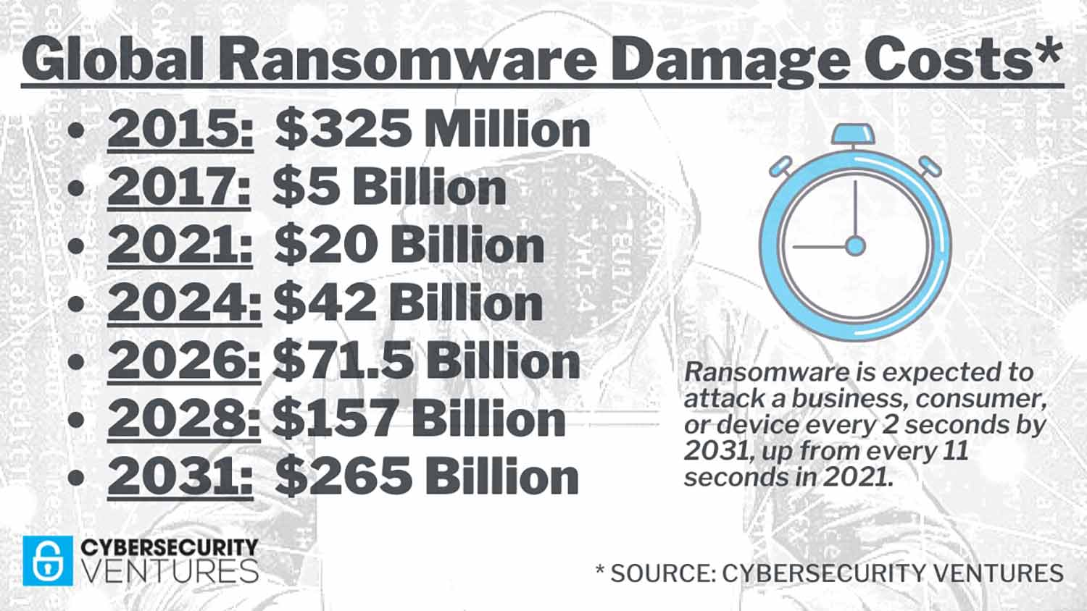

Slide 32
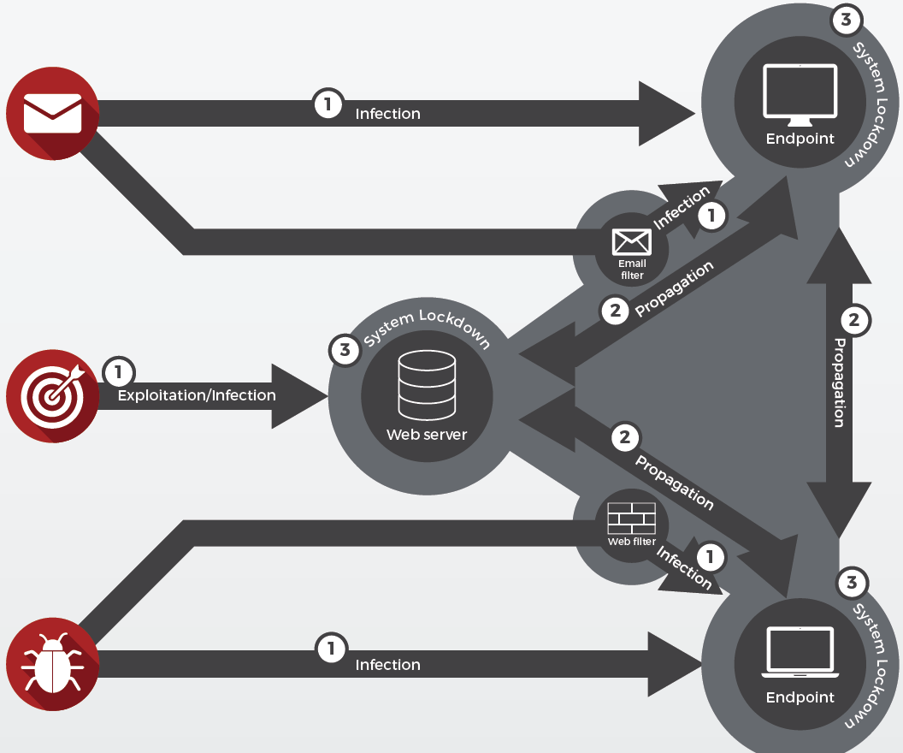
How a ransomware attack infects your systems:
Victim clicks on a malicious link or executable from an email and within minutes the malware locks all files on the system
Malware spreads through the network by collecting email addresses and credentials to move from system to system
Locked or encrypted files cannot be accessed without a decryption key from the attacker or from a vendor that has cracked the encryption and is offering the tool

Slide 33
In the Event of a Ransomware Attack
While these practices are effective, it is impossible to completely protect your organization from ransomware. If you do believe you have been the victim of a ransomware attack, consider the following steps:
Shut down your system. Physically unplug it if necessary.
Notify IT ASAP.
The faster IT is notified the faster the spread of the ransomware can be stopped.

Slide 34
Social Engineering – Phone Scams
Phone call scams vary in their approach:
Claim to be reputable businesses needing access or information
“…this is Microsoft calling to let you know we have seen malware on your computer… can you help us get remoted in to your computer to get it removed for you…”
Often convince you to provide information to “verify” you
“…your illegal browsing web history has been logged and will be reported to the authorities if you do not provide your social security number to prove who you are…”
Claim interruption of service or other negative consequences if you don’t comply
“…there is a billing issue with your account, can you please provide your credit card number for verification, otherwise services will be disconnected immediately…”

Slide 35
Social Engineering
Be aware of social engineering
Phone calls from unknown/unverified sources
USB drives from non-reputable sources or just lying around on a desk or table
CD/DVDs from non-reputable sources
Plugging in non-work phones/other devices
Password or login requests
Threatening or urgent abnormal requests
Requests for large sums of money
Co-workers acting strange over email

Slide 36
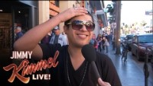

Slide 37
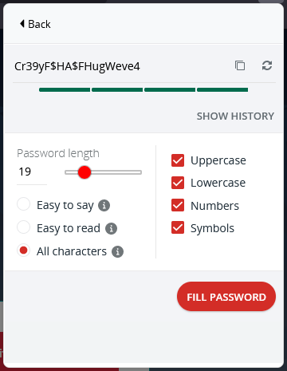
Password Tips
Get a Password Manager: LastPass, Keeper, NordPass. Pay for it! ($20 or so a year)
Use a password generator
Password length is more important than password complexity
Change your password regularly
Never share your password! Even with a coworker or vendor
Never write down or email your password
Avoid using your password twice
If you believe your password may be compromised change it immediately and report it!

Slide 38
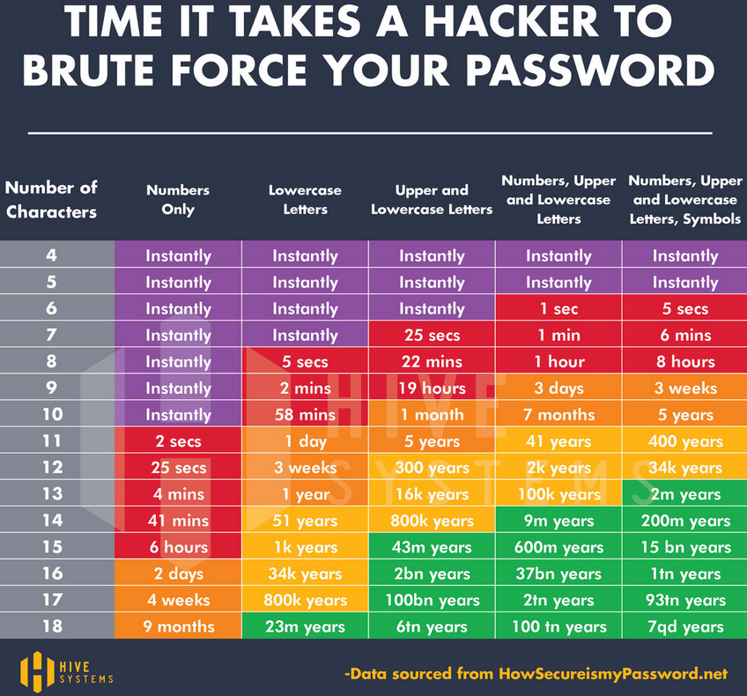

Slide 39
Other Safety Tips
Stay away from “Free” music/movie download sites as they generally contain malware disguised as media content. (It’s not free since you’re paying with personal data or hacks).
Practice safe web browsing habits by staying away from:
Social media links
Advertisements
Email links that are unfamiliar to you,
Even if from known sources, THEY MAY BE COMPROMISED.

Slide 40
Other Safety Tips
Lock computer when walking away
Always escort unknown guests
Never leave guests unattended within reach of technology or sensitive material
Report suspicious emails/calls/incidents
STOP and THINK before you CLICK!

Slide 41
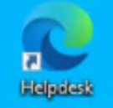
Options To Report A Possible Attack
Set up a helpdesk ticket using the icon found on your desktop or go to https://support.inftechnologies.com/
Send email to: itservices@ci.Atherton.ca.us
Call the Helpdesk at 916.224.2736

Slide 42
Thank you!
Questions?

