Slide 1
Town of Atherton
SB 79 Ordinance
Transit-Oriented Housing
Public Workshop
January 20, 2025

Slide 2
Agenda
Project Schedule
What is SB 79?
SB 79 in Atherton
Development Approach
Design Strategies
Other Development Issues
Summary and Next Steps

Slide 3
Project Schedule
Public Workshop
(Tonight)
Planning Commission
Meeting
Jan 28
City Council 1st Reading
Feb 18
City Council 2nd Reading
Mar 18
HCD Review Period
(90 Days)
Ordinance in Place
Jul 1

Slide 4
What is SB 79?
Signed into law by Gov. Gavin Newsom on Oct. 10, 2025,
Senate Bill (SB) 79 overrides local zoning limitations to allow greater heights and densities for residential development near transit stops (including Caltrain).
Within ¼-mile of the Menlo Park Caltrain Station, Atherton must allow:
Building heights up to 75 feet
Minimum residential density of 120 units/acre
Minimum floor area ratio (FAR) of 3.5

Slide 5
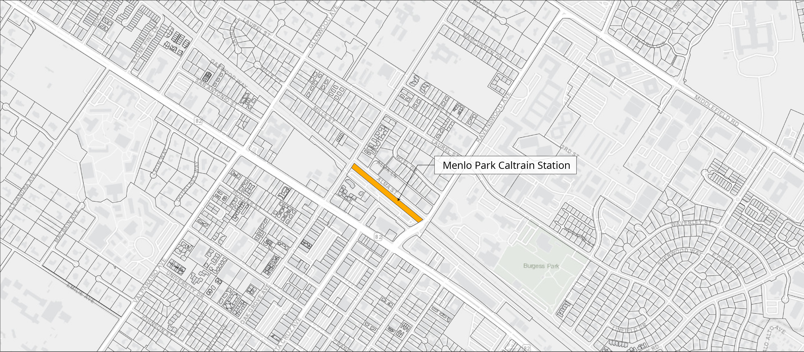
SB 79 in Atherton
Glenwood Ave
Laurel St
El Camino Real
Valparaiso Ave

Slide 6
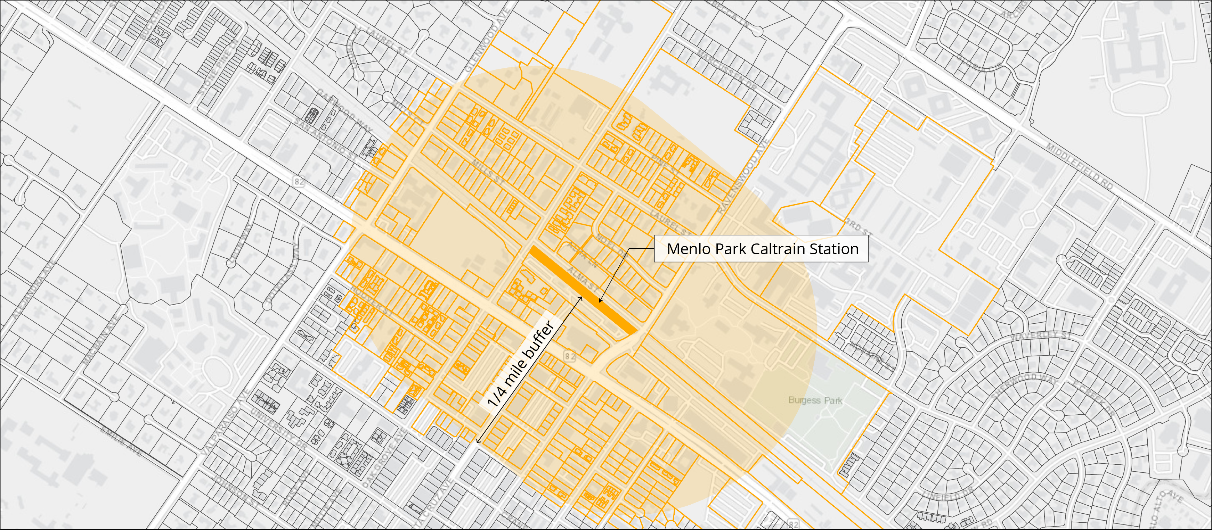
SB 79 in Atherton
Glenwood Ave
Laurel St
El Camino Real
Valparaiso Ave

Slide 7
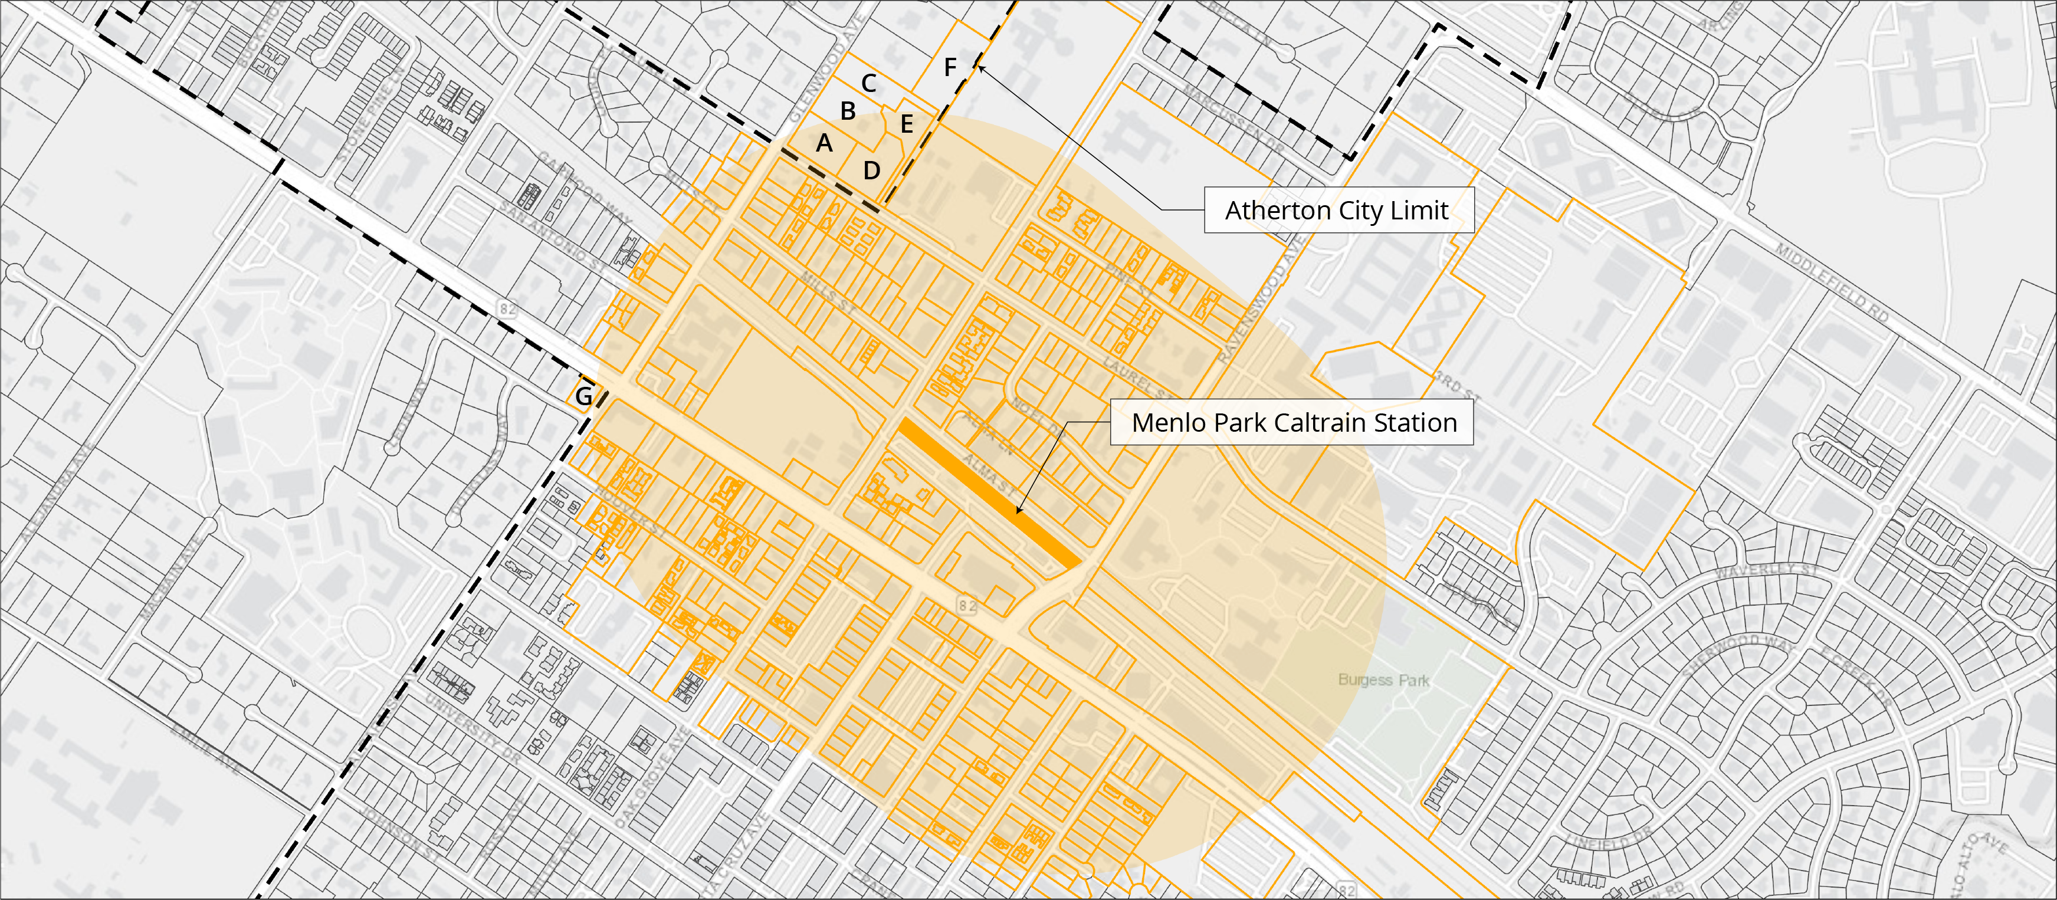
SB 79 in Atherton
Glenwood Ave
Laurel St
Site | Address
A | 110 Glenwood
B | 120 Glenwood
C | 124 Glenwood
D | 155 Laurel
E | 147 Laurel
F | 151 Laurel
G | 99 Victoria
ADD TABLE
El Camino Real
Valparaiso Ave

Slide 8
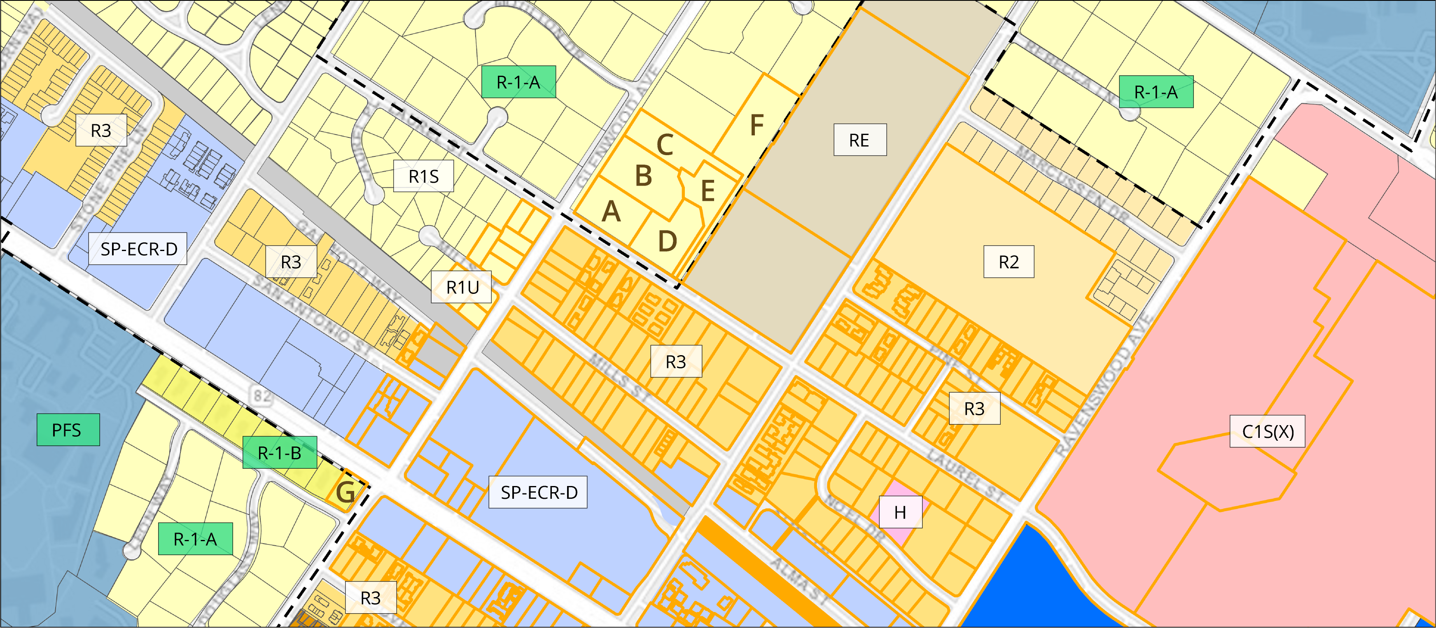
SB 79 in Atherton
Atherton
Menlo Park
Glenwood Ave
Laurel St
Menlo Park
Legend
 | Atherton Zoning
 | Menlo Park Zoning
 | Parcel Line
 | SB 79 Parcel Line
Atherton
El Camino Real
Valparaiso Ave

Slide 9
SB 79 in Atherton
Lot | Address | R-1 Adjacent (Y/N) | Flag Lot (Y/N) | Lot Size (ac) | Development Potential* | 3.5 FAR Floor Area Potential (sf)
A | 110 Glenwood | Y | N | 1.00 | 30-120 du | 152,460 sf
B | 120 Glenwood | Y | N | 1.31 | 40-158 du | 199,723 sf
C | 124 Glenwood | Y | N | 0.98 | 30-118 du | 149,411 sf
D | 135 Laurel | Y | N | 1.08 | 33-130 du | 164,657 sf
E | 147 Laurel | Y | Y | 0.80 | 24-96 du | 121,968 sf
F | 151 Laurel | Y | Y | 1.85 | 56-222 du | 282,051 sf
G | 99 Victoria | Y | N | 0.31 | 10-38 du | 47,263 sf
*To qualify for SB 79 a project must develop a minimum of 30 du/ac

Slide 10
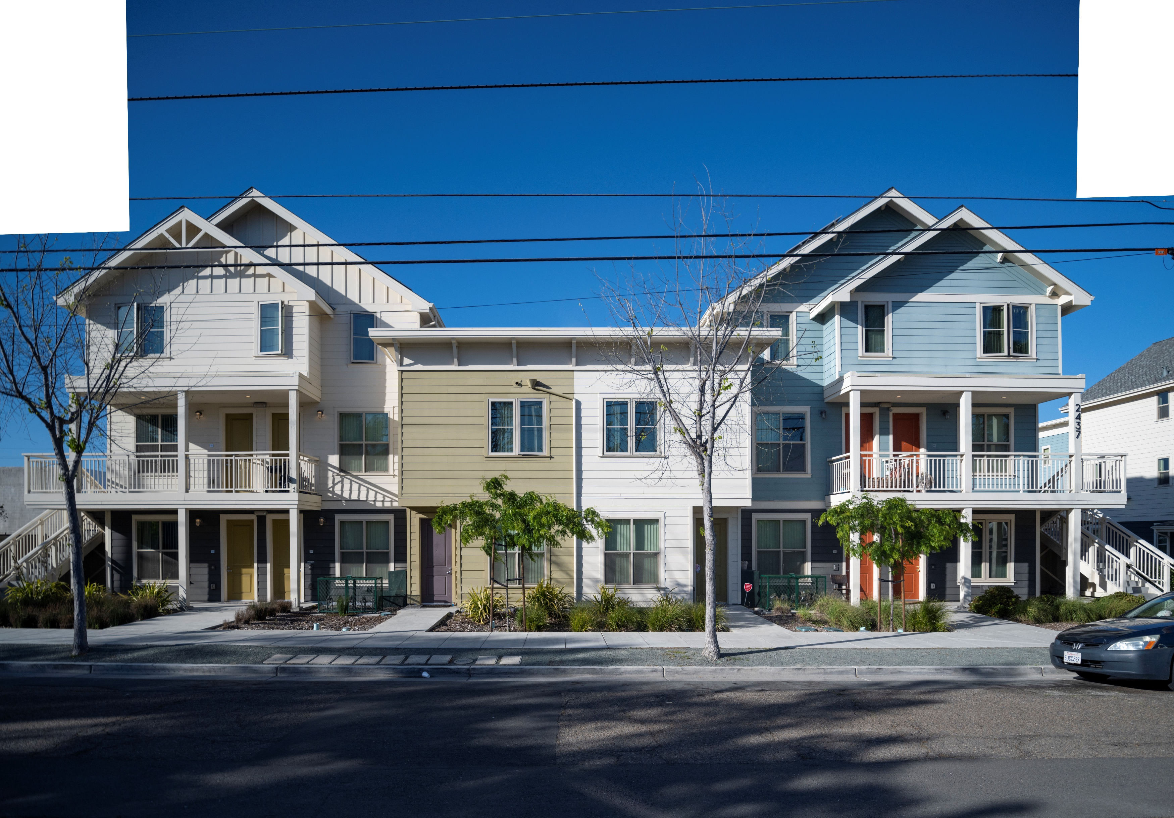
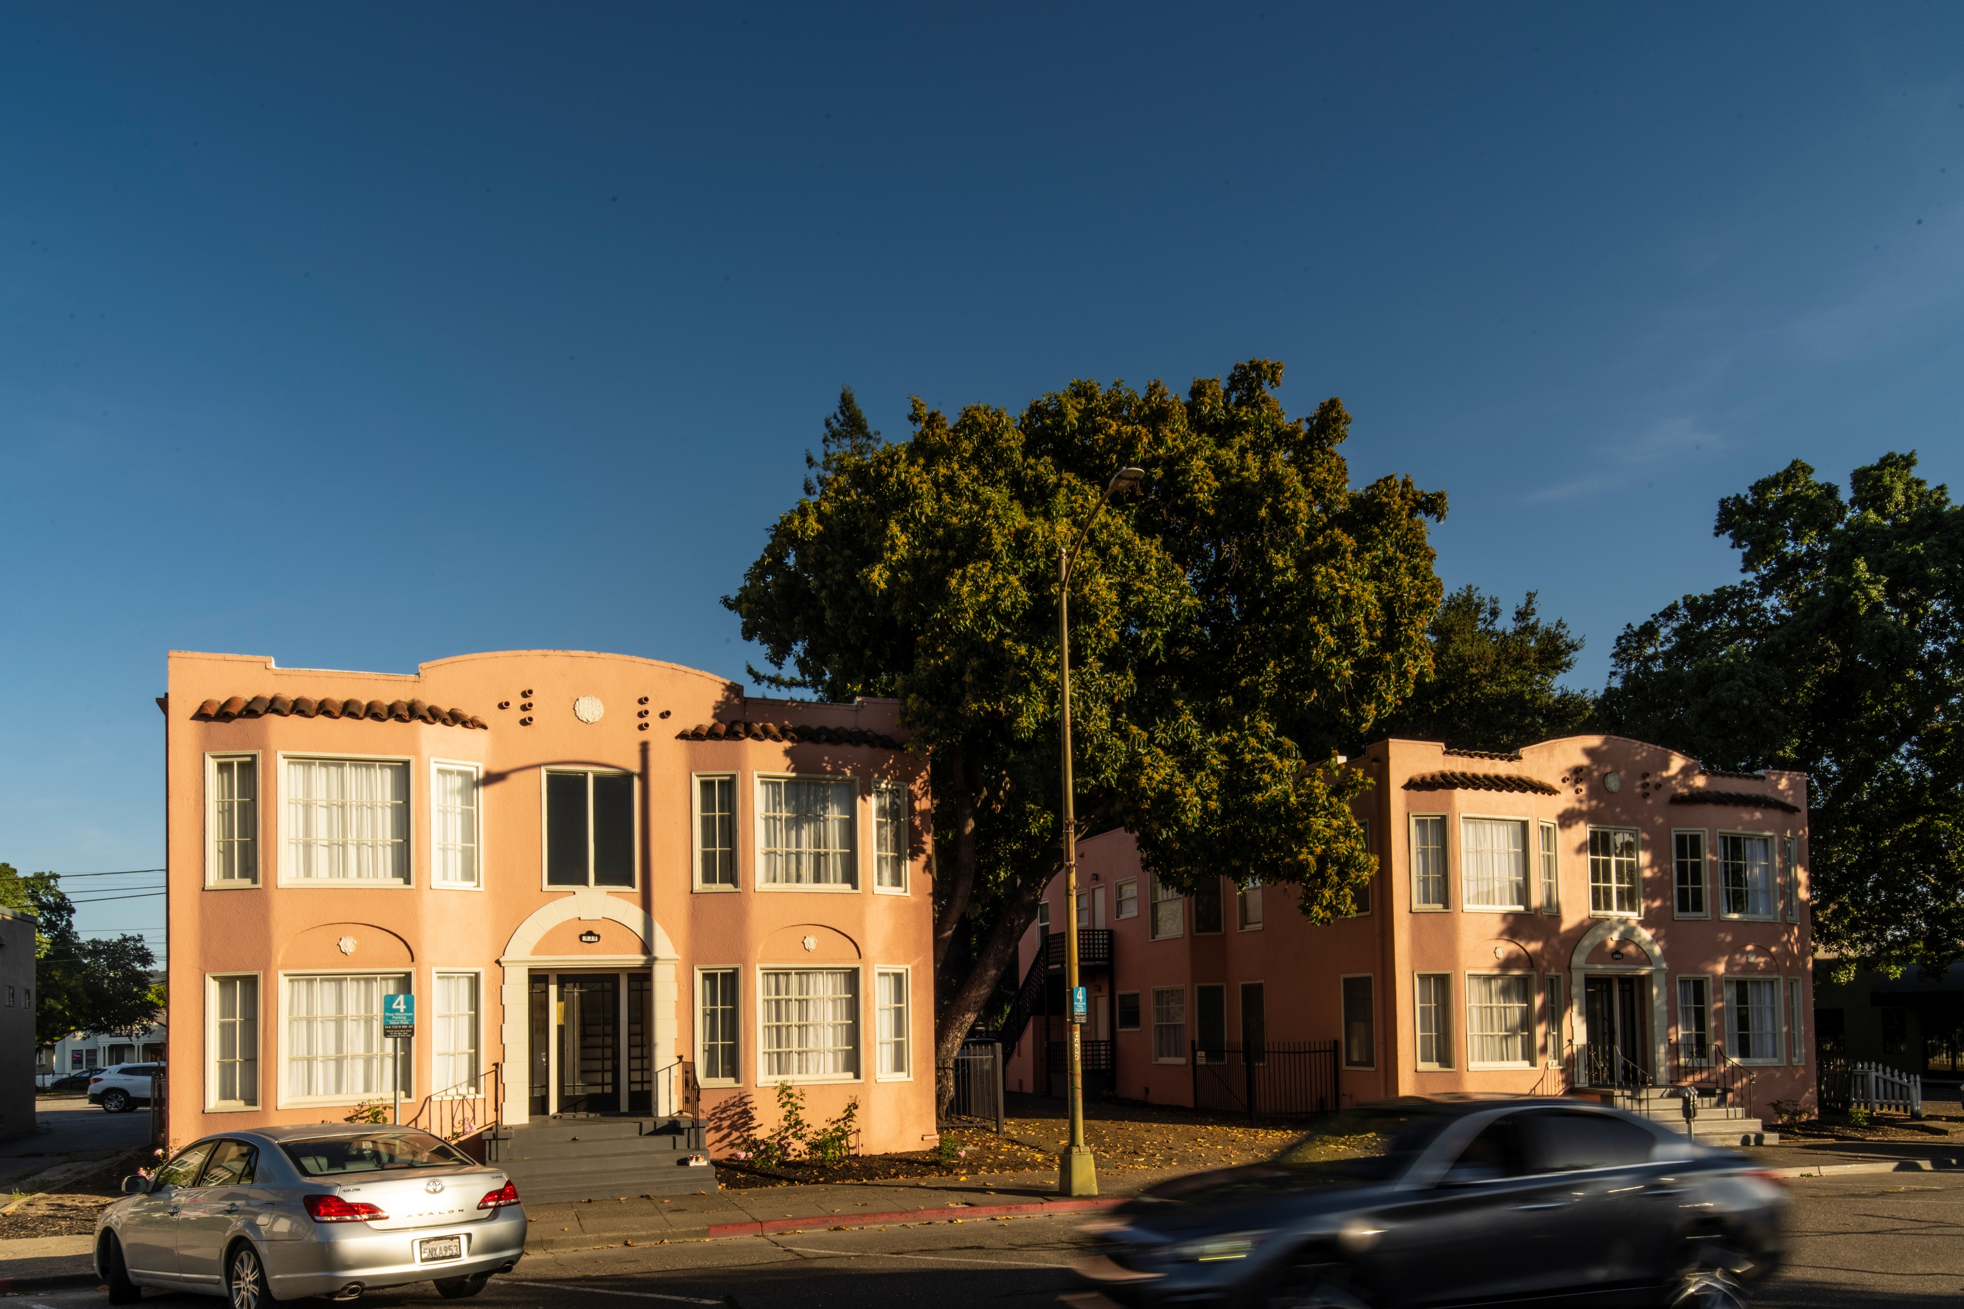
Reference Images for Density
30 Dwelling Units per Acre
Source: ABAG

Slide 11
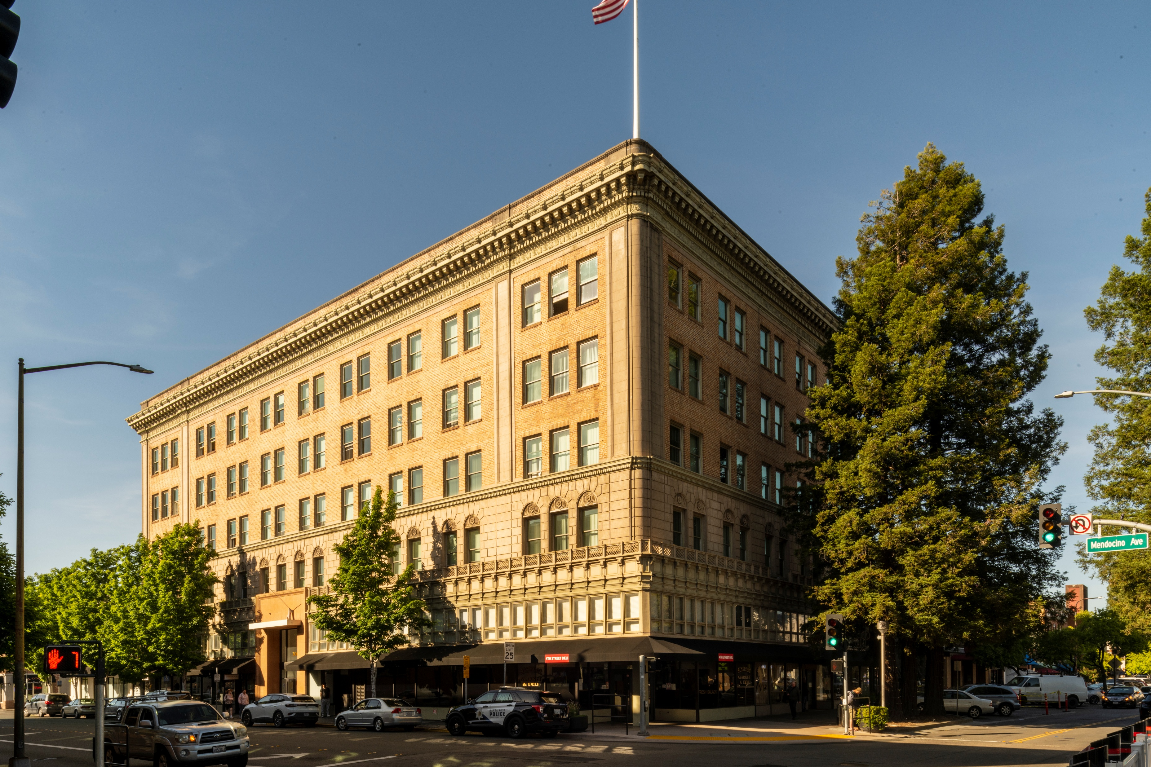
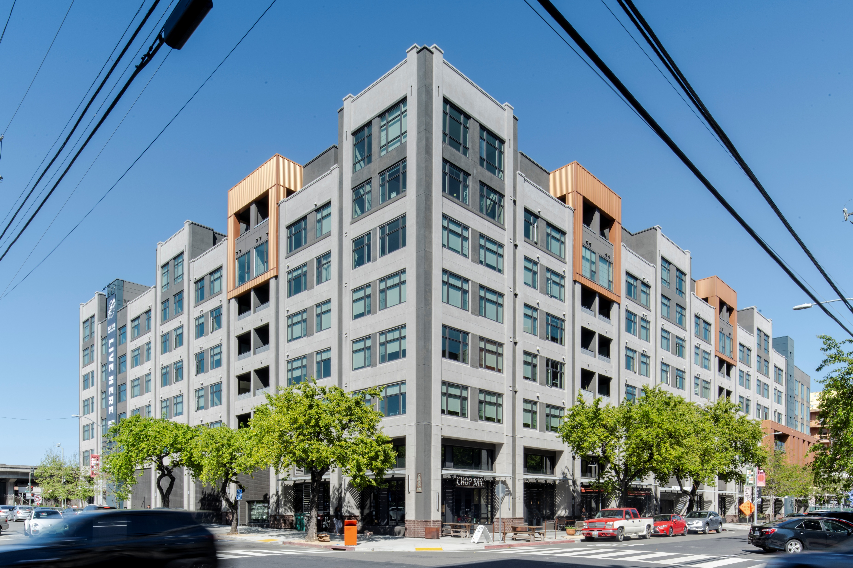
Reference Images for Density
120 Dwelling Units per Acre
Source: ABAG

Slide 12
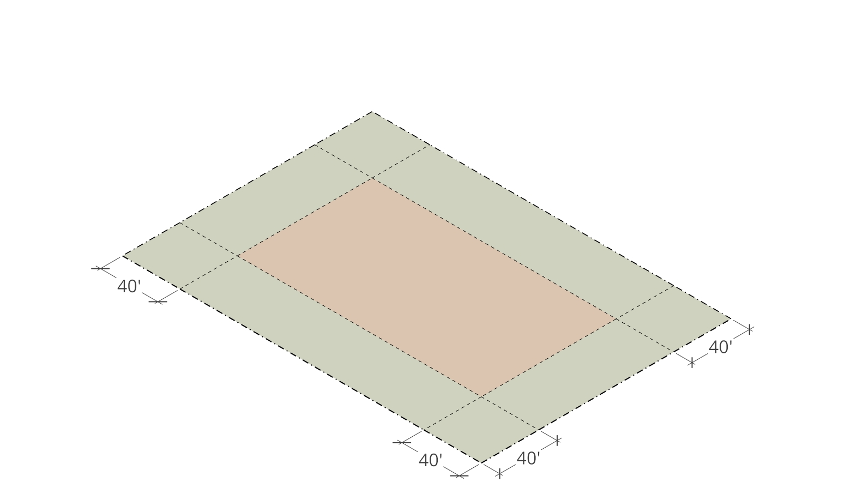
Development Approach -Setbacks
Base Case:
RM-40 Setbacks: 40 feet
Glenwood Ave
R-1A Lot
Laurel Street
R-1A Lot
110 Glenwood

Slide 13
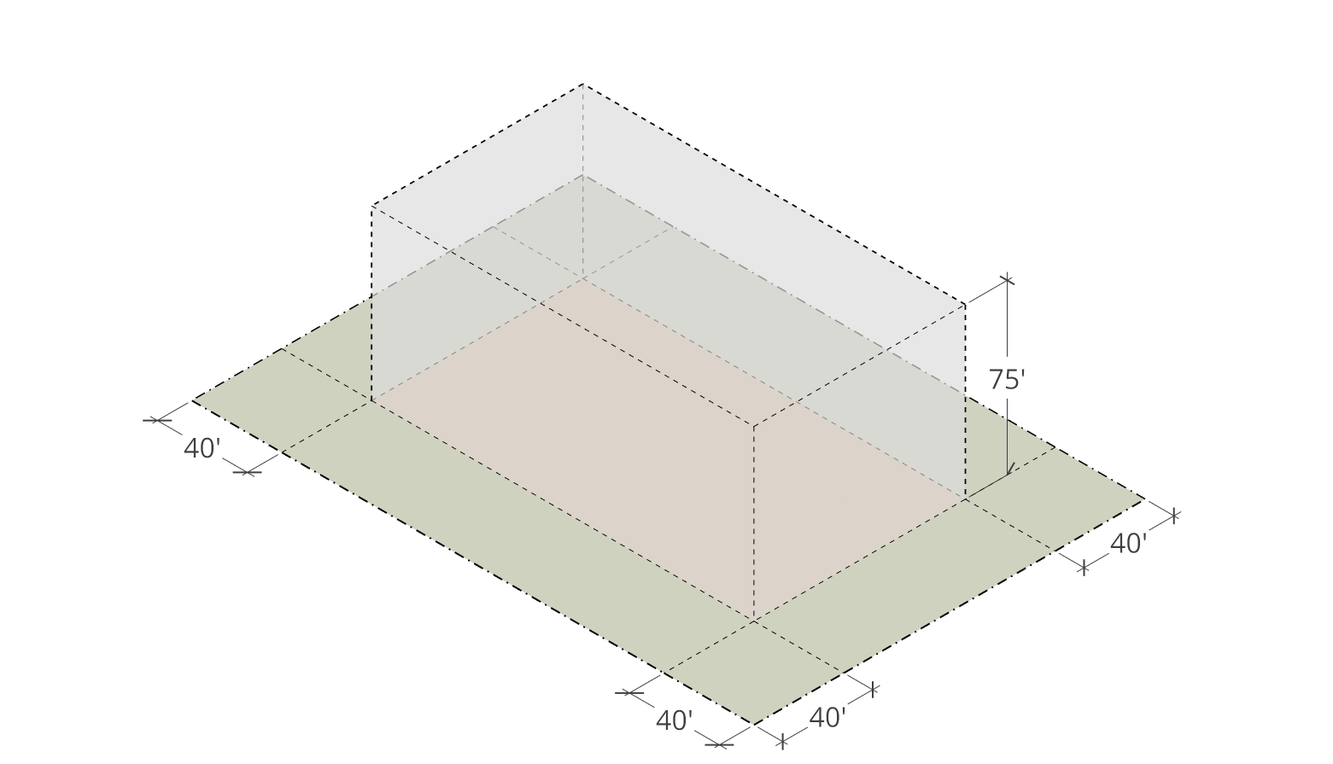
Development Approach - Height
Base Case:
RM-40 Setbacks: 40 feet
SB 79 Requirements:
Height: 75 feet
Glenwood Ave
R-1A Lot
Laurel Street
R-1A Lot
110 Glenwood

Slide 14
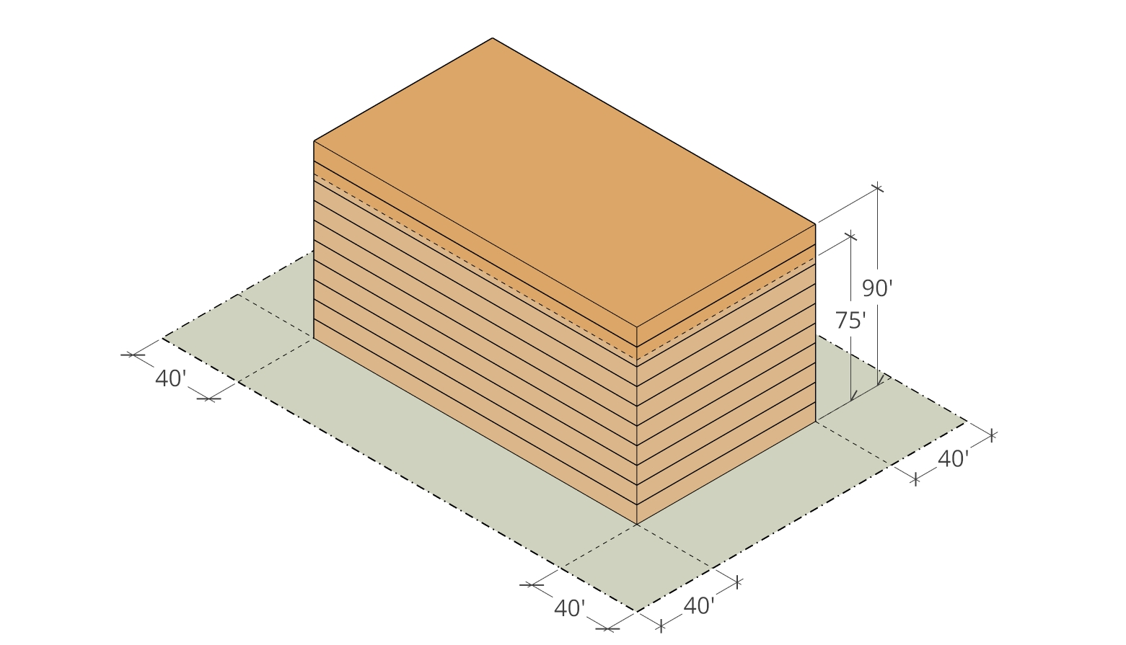
Development Approach - FAR
Base Case:
RM-40 Setbacks: 40 feet
SB 79 Requirements:
Height: 75 feet
FAR: 3.5
Implication:
Height: 90 feet
10 Stories
Glenwood Ave
R-1A Lot
Laurel Street
R-1A Lot
110 Glenwood

Slide 15
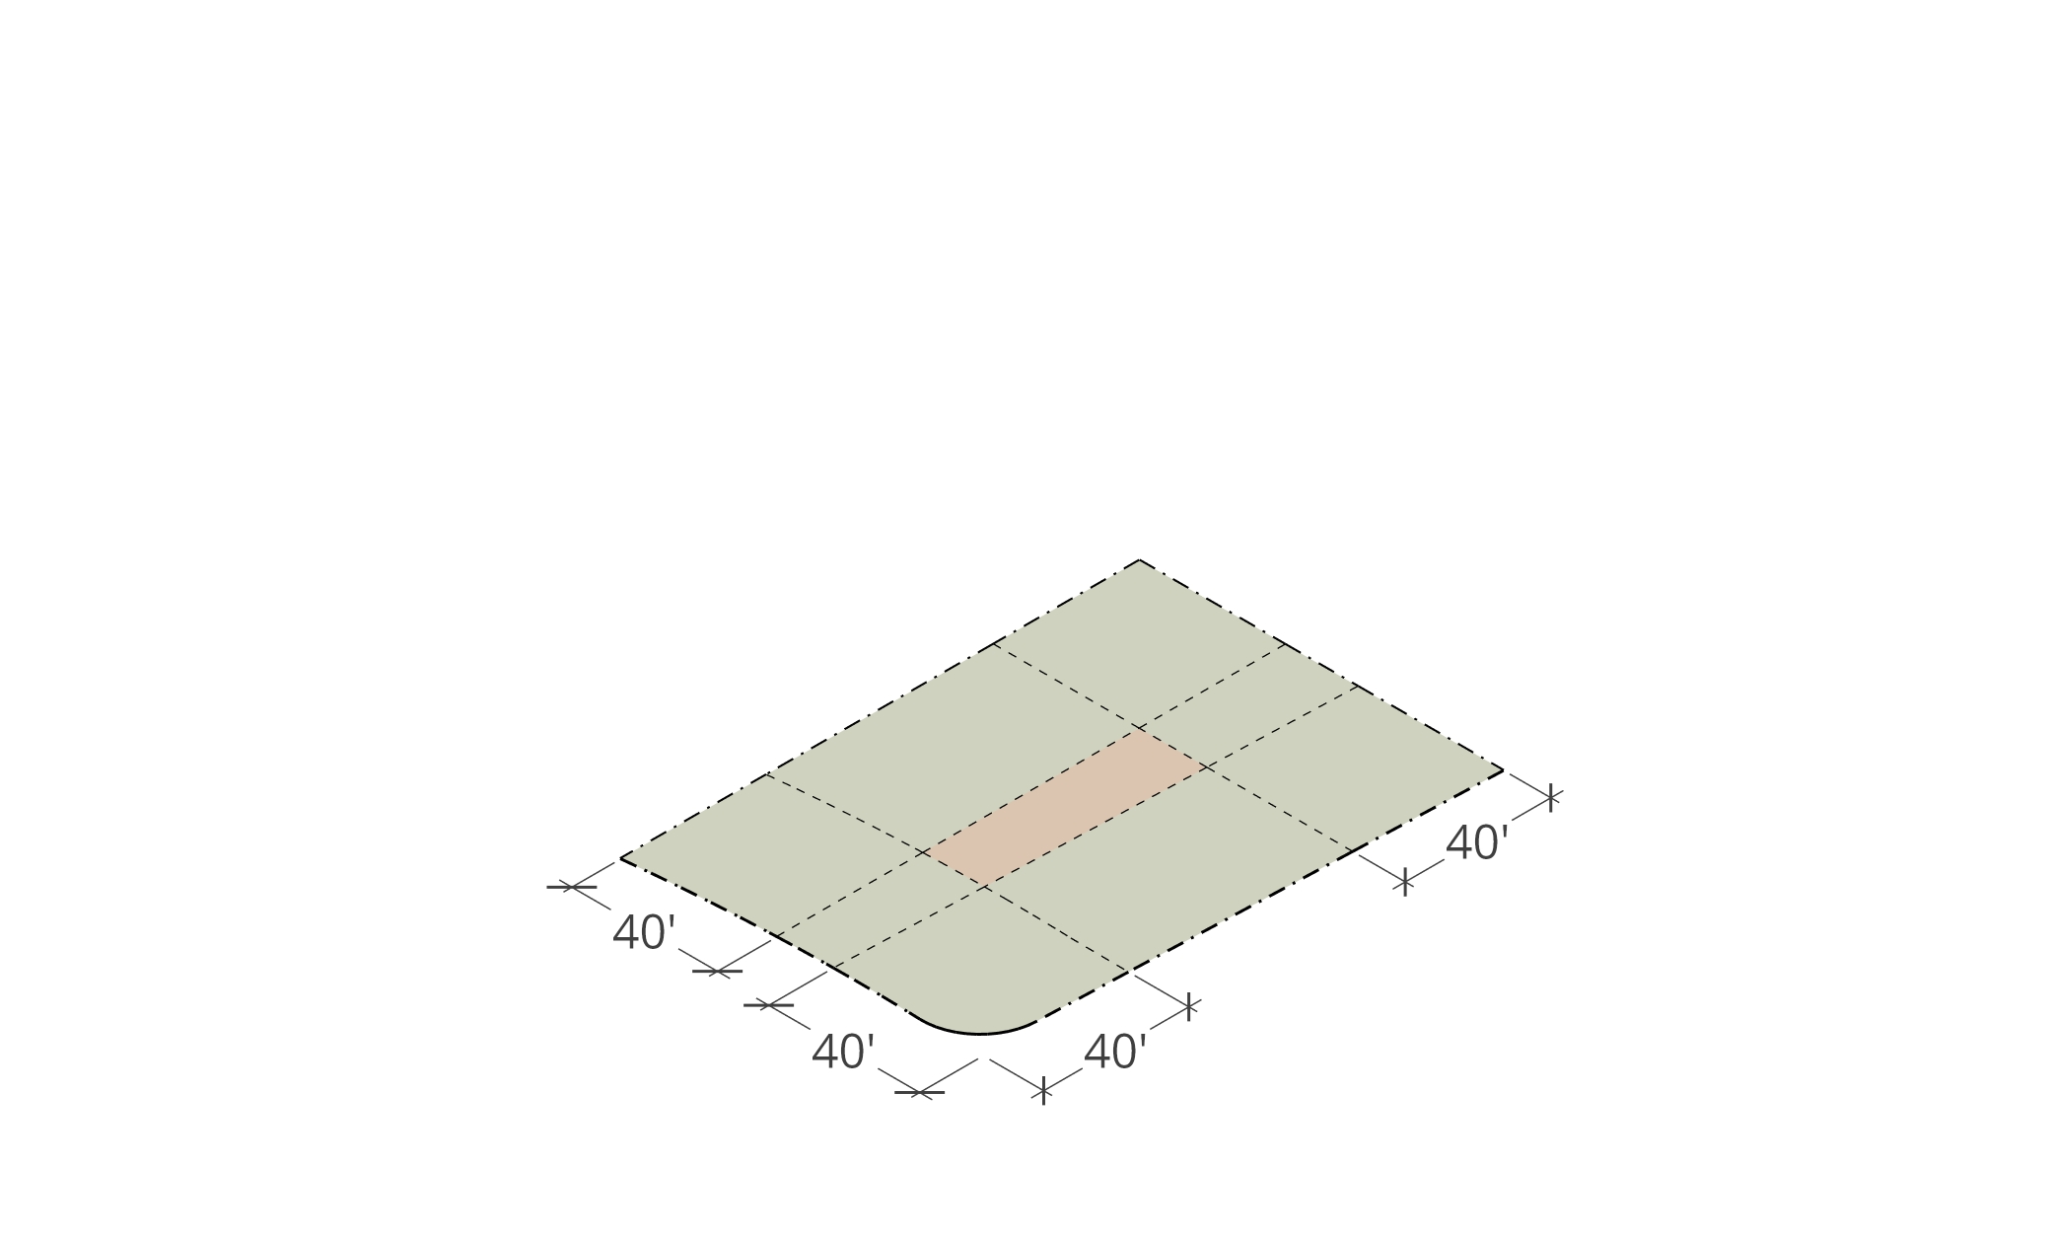
Development Approach -Setbacks
Base Case:
RM-40 Setbacks: 40 feet
R-1B Lot
El Camino
Real
Valparaiso Ave
Victoria Ave
99 Victoria

Slide 16
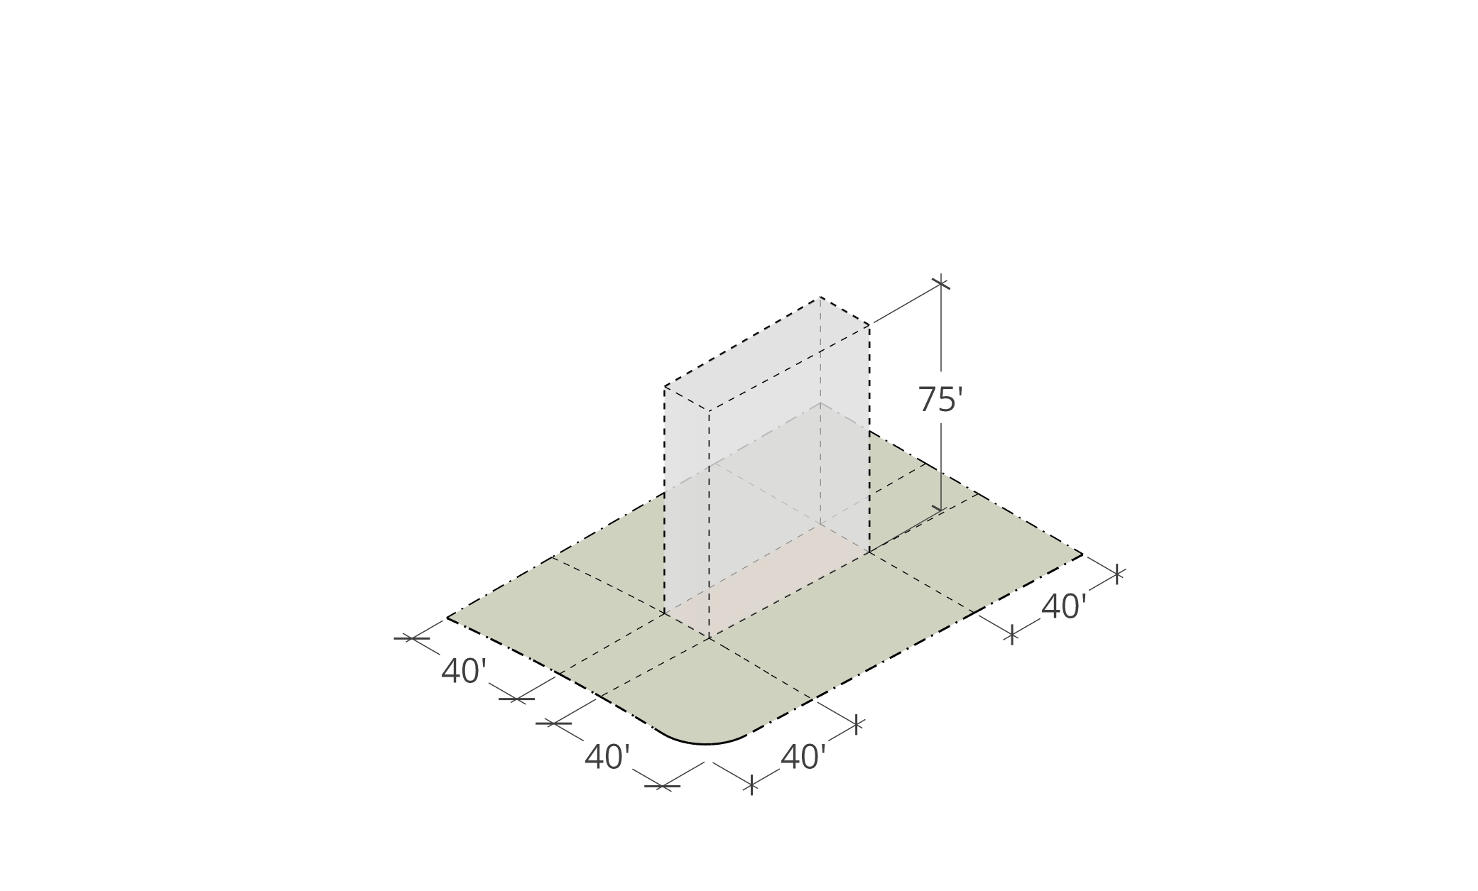
Development Approach - Height
Base Case:
RM-40 Setbacks: 40 feet
SB 79 Requirements:
Height: 75 feet
R-1B Lot
El Camino
Real
Valparaiso Ave
Victoria Ave
99 Victoria

Slide 17
Pause for Questions
Notes:
It is my understanding that when the Lindenwood subdivision was originally subdivided, property owners were provided the opportunity to select which property line would be considered the front property line for the purposes of development. In this case, the original building permit for the main construction identified Laburnum Road as the front property line , where in other properties identified a wider frontage to be selected and considered the front. AMC Chapter 16.08.100 on Front Lot Lines:
The front lot line is the boundary of a lot whose narrowest portion abuts a public street or access… except where a different front has been previously officially designated or recognized by the Town.
In this case, the narrower lot line, Laburnum Road has long been previously recognized as the front lot line for the property, and therefore, this designation continues with the new development… And with that foundation, we are recommending denial for the proposed project.

Slide 18
Refine Development Approach
Base Case:
RM-40 Setbacks: 40 feet
SB 79 Requirements:
Height: 75 feet
FAR: 3.5
Implication:
Height: 90 feet
10 Stories
Glenwood Ave
R-1A Lot
Laurel Street
R-1A Lot
110 Glenwood

Slide 19
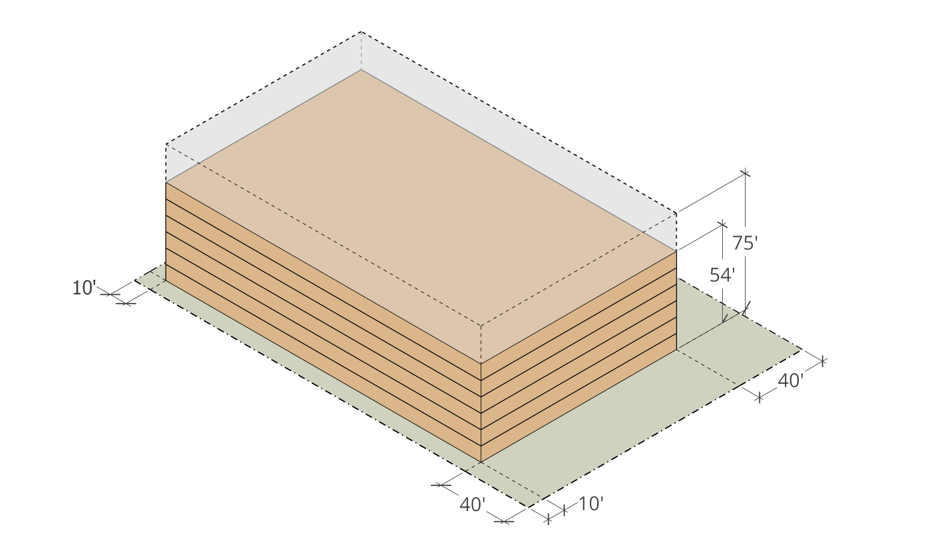
Setback Scenario – Minimum Frontage
SCENARIO 1: Minimum Frontage
Setbacks:
Front: 10 feet
Rear: NA
Side: NA
R-1 Adjacent: 40 feet
SB 79 Requirements:
Height: 75 feet min.
FAR: 3.5 min.
Implication:
Height: 54 feet
6 Stories
Glenwood Ave
R-1A Lot
Laurel Street
R-1A Lot
110 Glenwood

Slide 20
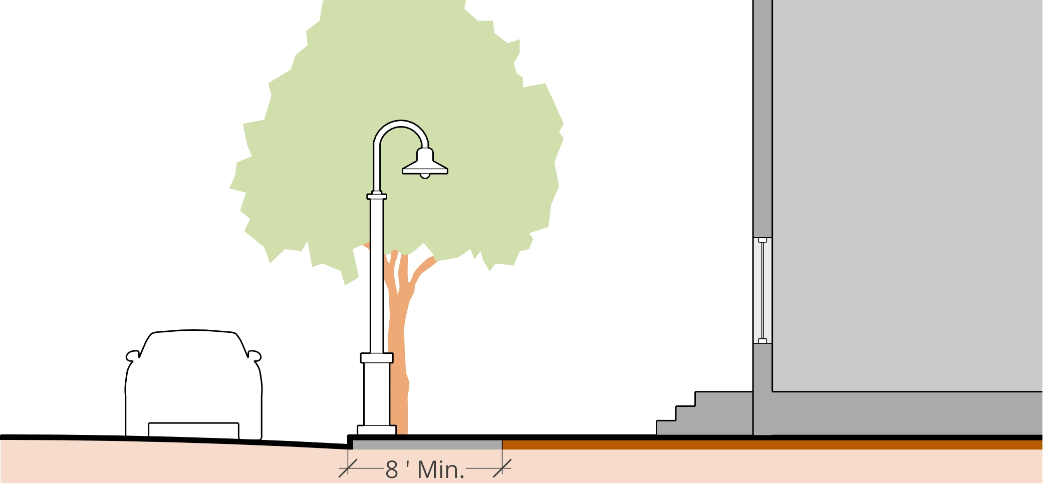
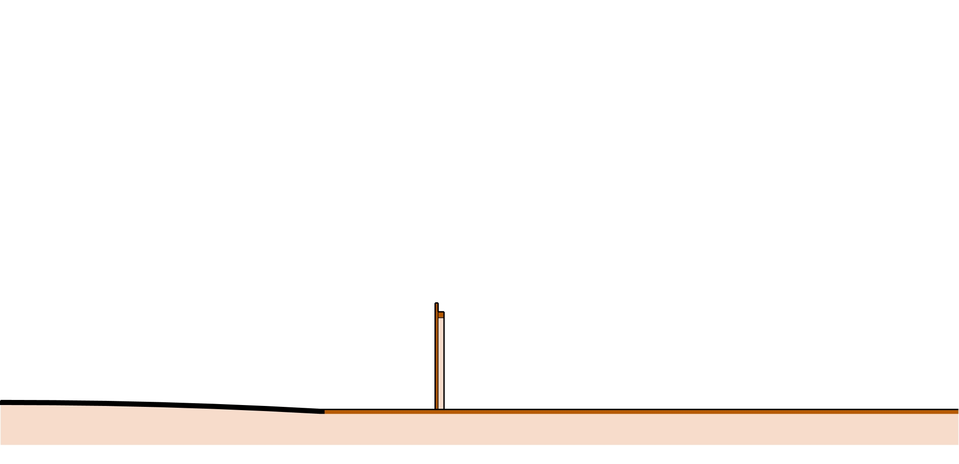
Setback Scenarios – Frontage Design
Proposed Frontage
Minimum sidewalk requirement
Street lighting standards
Street trees at regular intervals
Street Trees
15’
Front
Setback
Lighting
Sidewalk
Property Line
Existing Frontage

Slide 21
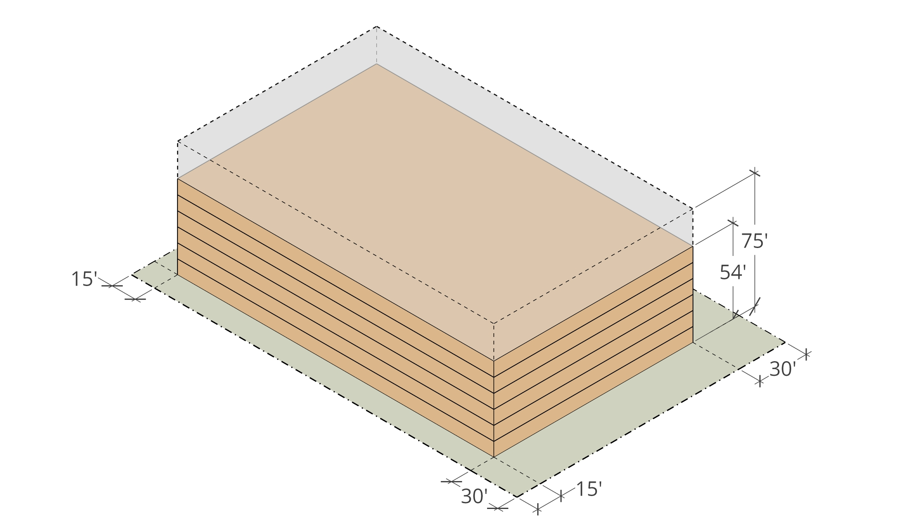
Setback Scenario – Pedestrian Frontage
SCENARIO 2: Pedestrian Frontage
Setbacks:
Front: 15 feet
Rear: NA
Side: NA
R-1 Adjacent: 30 feet
SB 79 Requirements:
Height: 75 feet min.
FAR: 3.5 min.
Implication:
Height: 54 feet
6 Stories
Glenwood Ave
R-1A Lot
Laurel Street
R-1A Lot
110 Glenwood

Slide 22
Incentive for Upper Floor Setbacks
Can we maintain a pedestrian-supportive front setback AND reduce height impacts adjacent to R1 development?
35-foot maximum height Zone adjacent to R1
0.5 FAR incentive
No change to density
No change to height

Slide 23
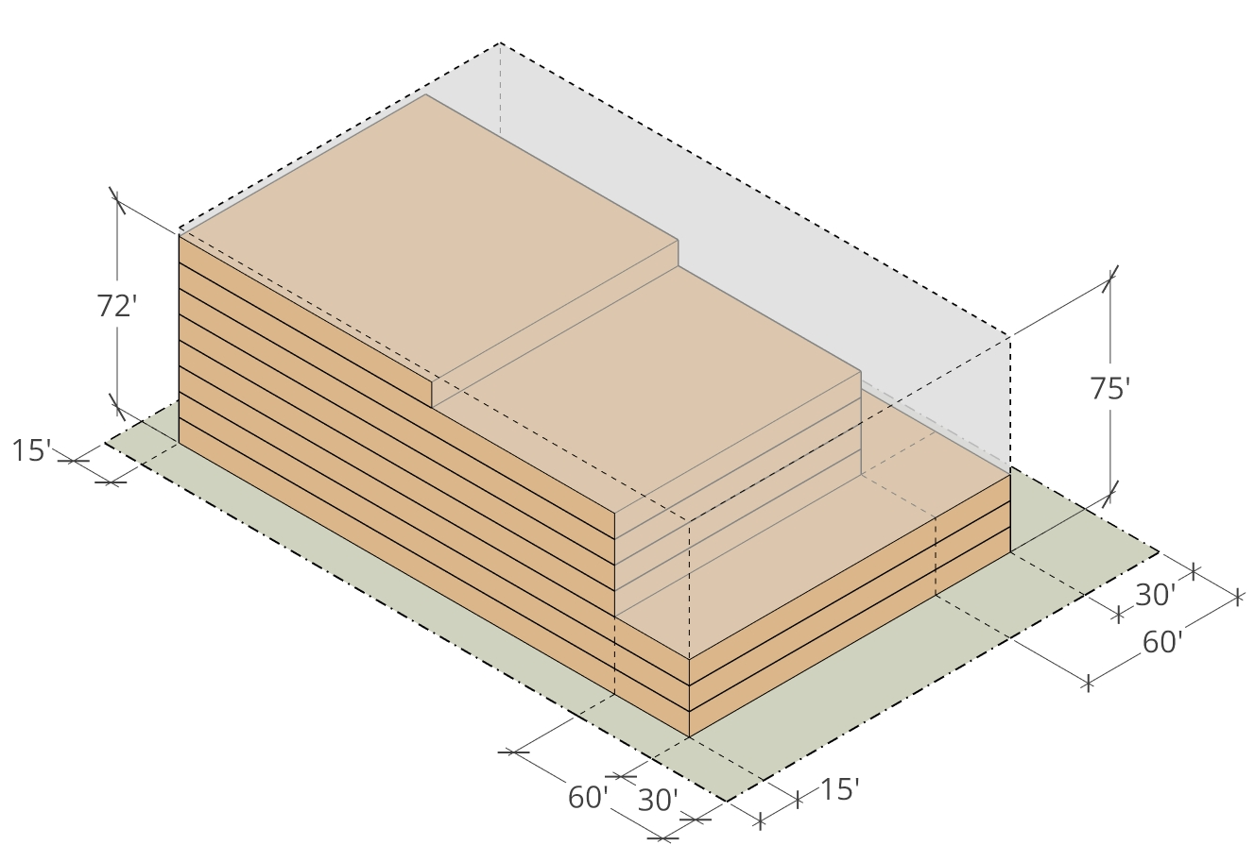
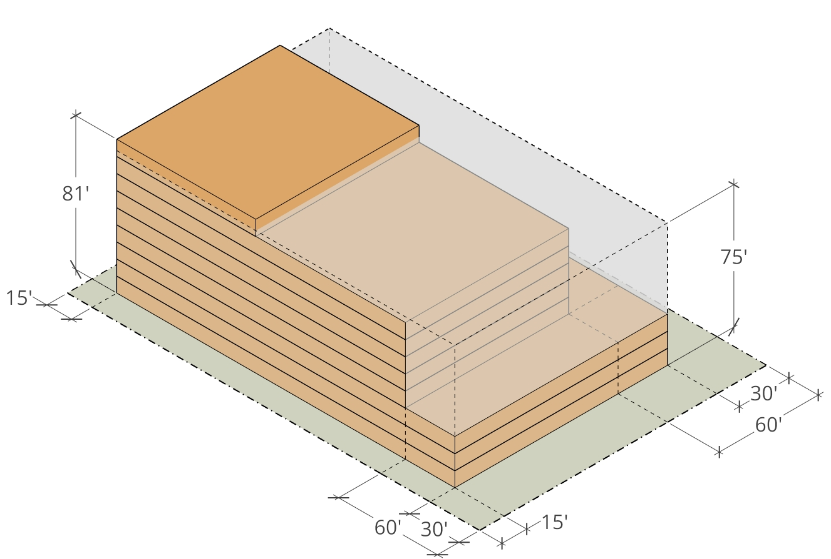
Incentive for Upper Floor Setbacks
Upper-floor setbacks are incentivized through an increased FAR allowance (up to 4.0).
Glenwood Ave
Glenwood Ave
R-1A Lot
R-1A Lot
UPDATE IMAGE
Laurel Street
Laurel Street
R-1A Lot
R-1A Lot
3.5 FAR
4.0 FAR

Slide 24
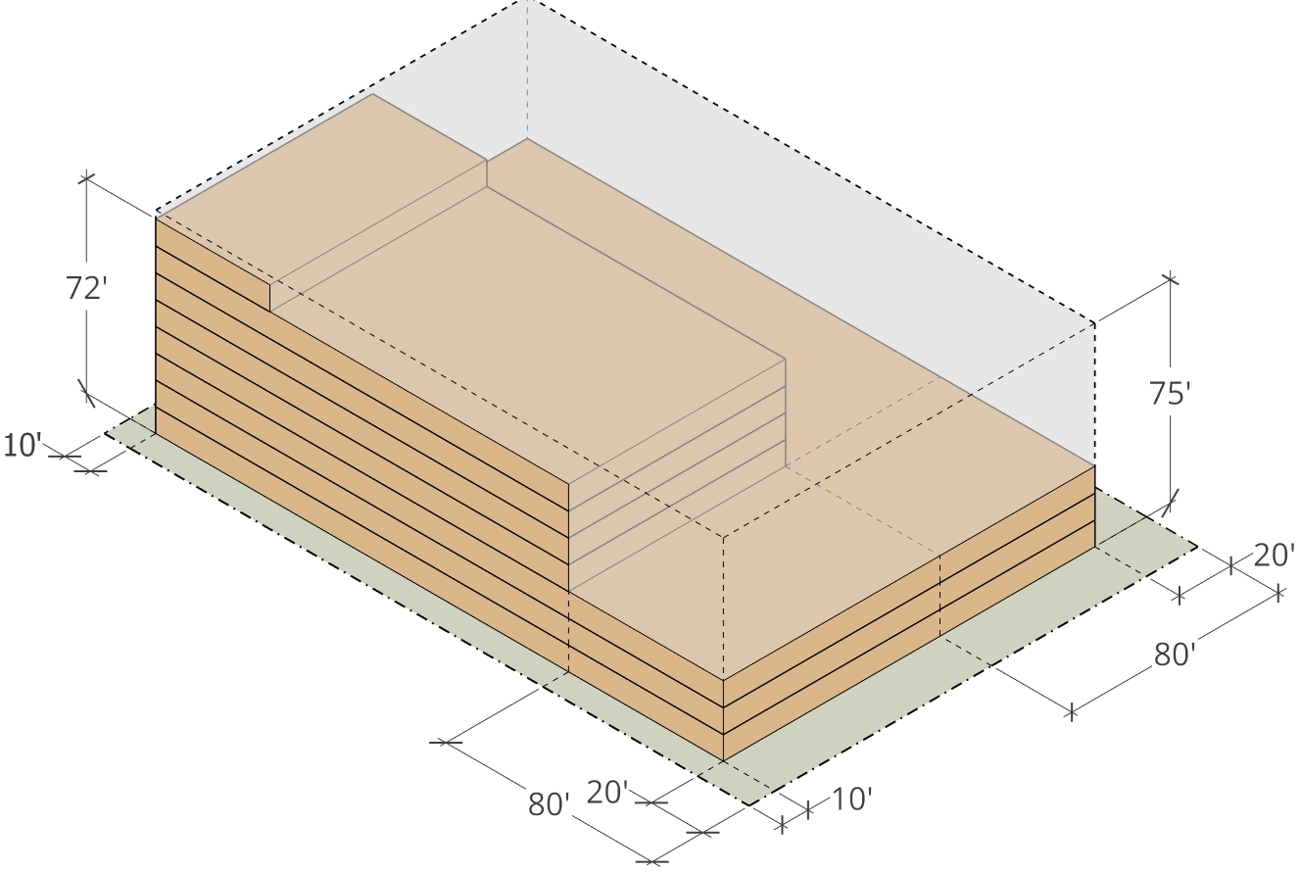
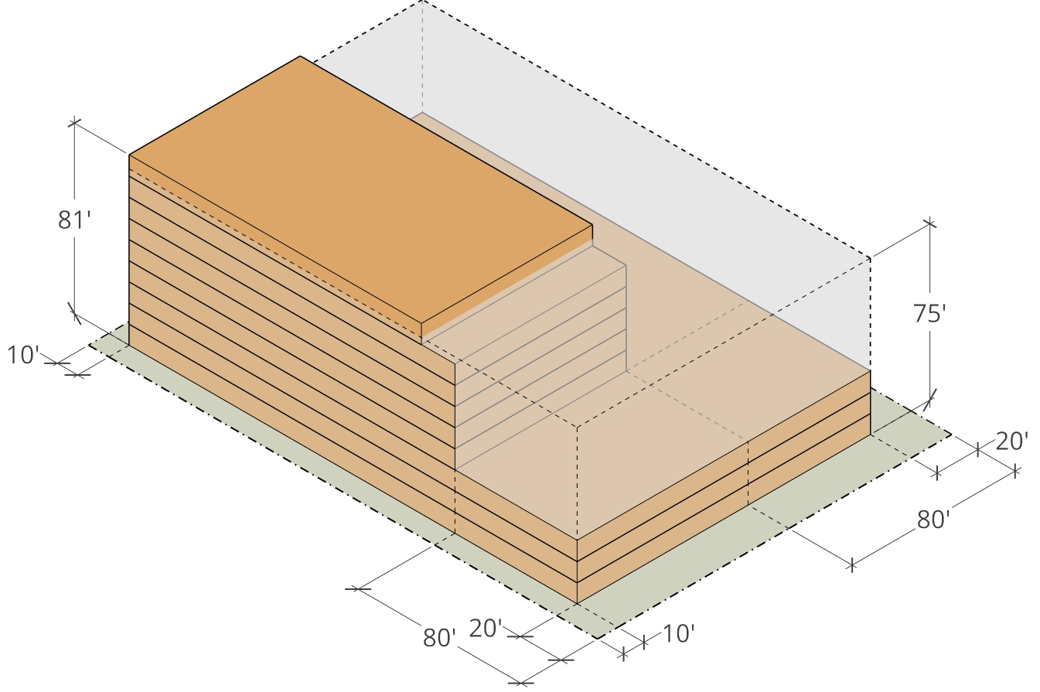
Incentive for Upper Floor Setbacks
Upper-floor setbacks are incentivized through an increased FAR allowance (up to 4.0).
Glenwood Ave
Glenwood Ave
R-1A Lot
R-1A Lot
UPDATE IMAGE
Laurel Street
Laurel Street
R-1A Lot
R-1A Lot
3.5 FAR
4.0 FAR

Slide 25
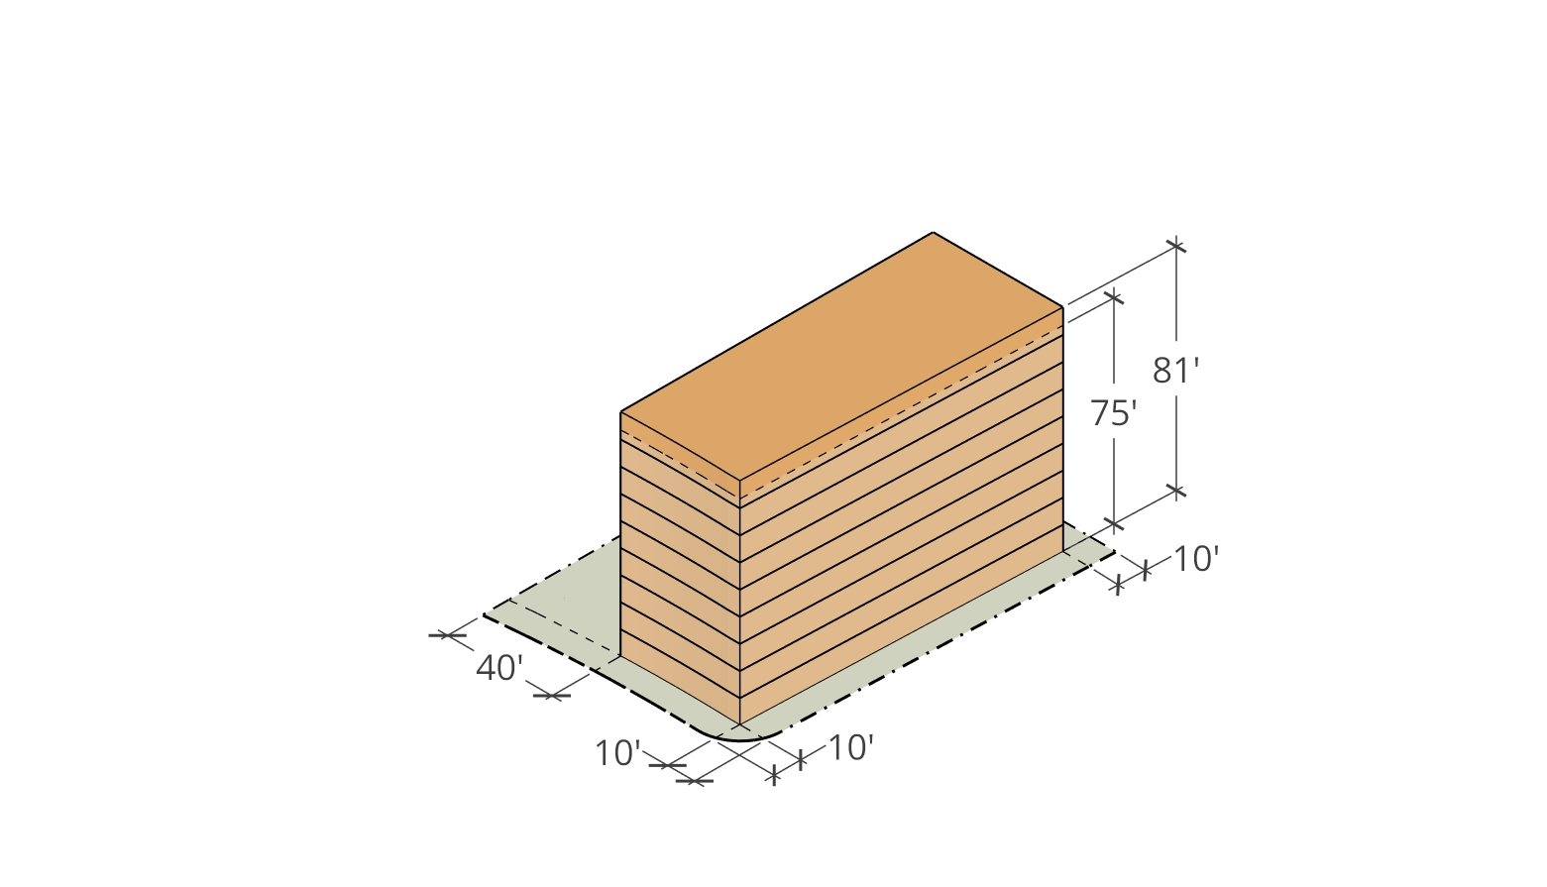
Setback Scenarios – Lots < ½ Acre
SCENARIO 1: Minimum Frontage
Setbacks:
Front: 10 feet
Rear: NA
Side: NA
R-1 Adjacent: 40 feet
SB 79 Requirements:
Height: 75 feet min.
FAR: 3.5 min.
Implication:
Height: 81 feet
9 Stories
R-1B Lot
El Camino
Real
Valparaiso Ave
Victoria Ave
99 Victoria

Slide 26
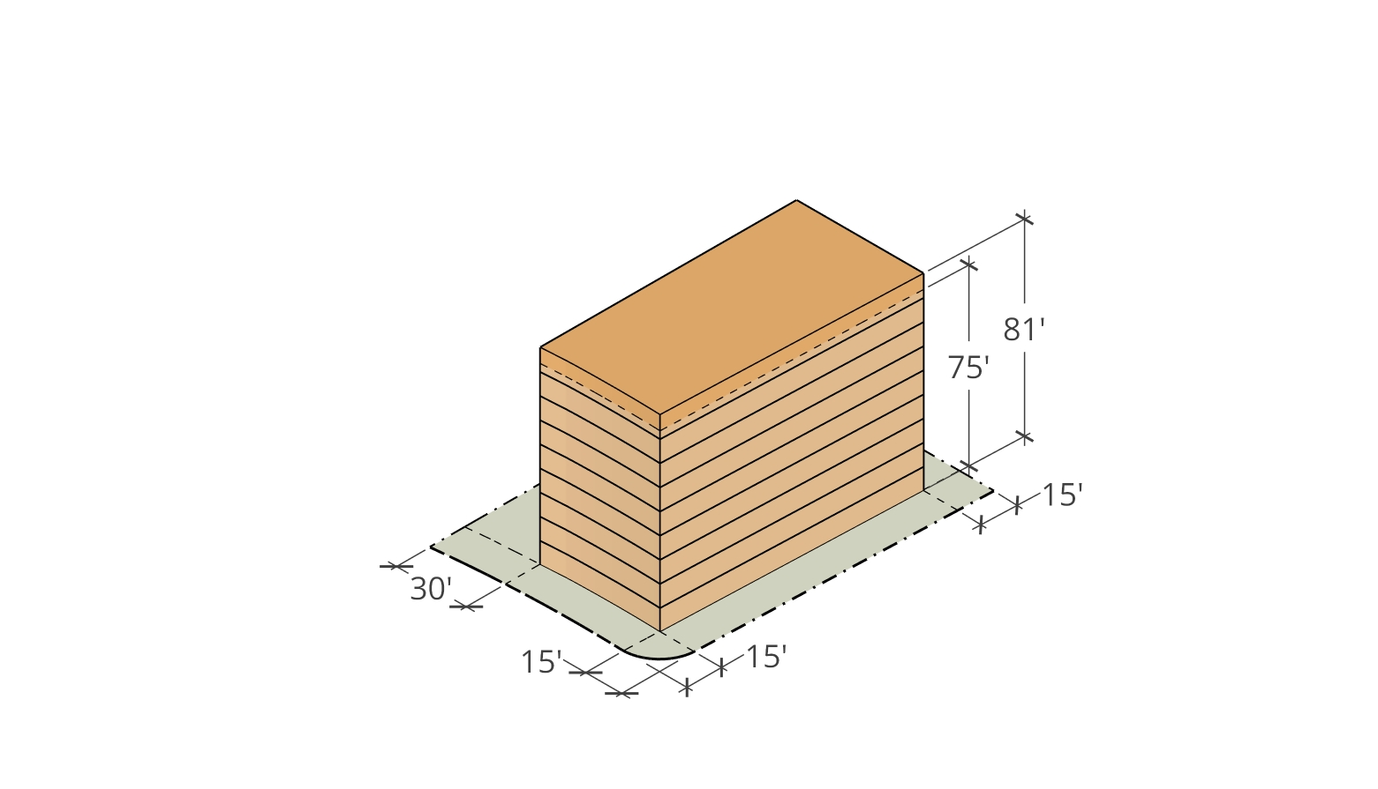
Setback Scenarios – Lots < ½ Acre
SCENARIO 2: Minimum Frontage
Setbacks:
Front: 15 feet
Rear: NA
Side: NA
R-1 Adjacent: 30 feet
SB 79 Requirements:
Height: 75 feet min.
FAR: 3.5 min.
Implication:
Height: 81 feet
9 Stories
R-1B Lot
El Camino
Real
Valparaiso Ave
Victoria Ave
99 Victoria

Slide 27
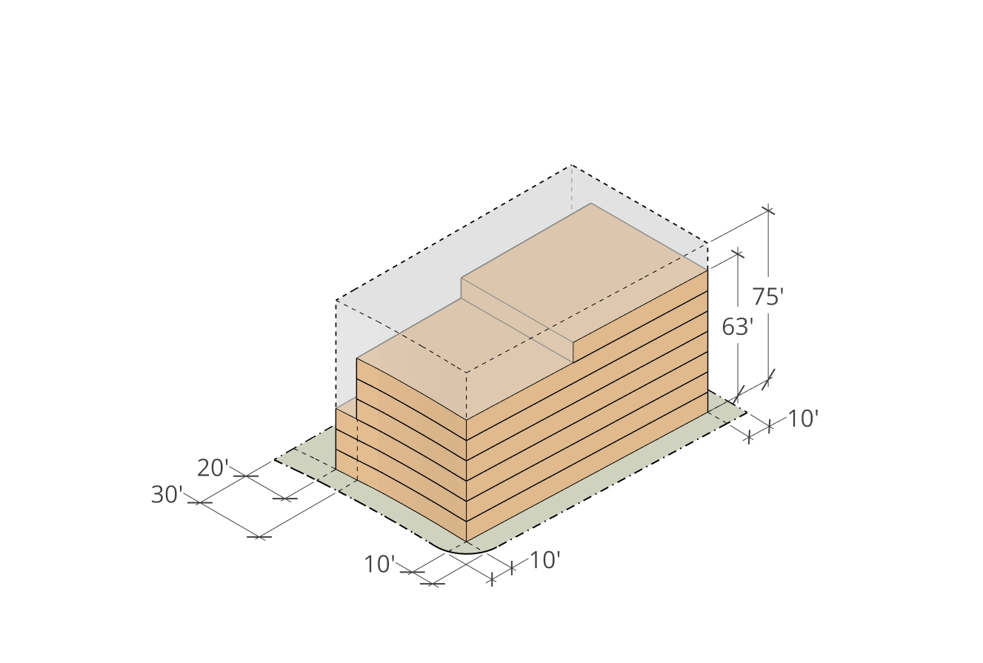
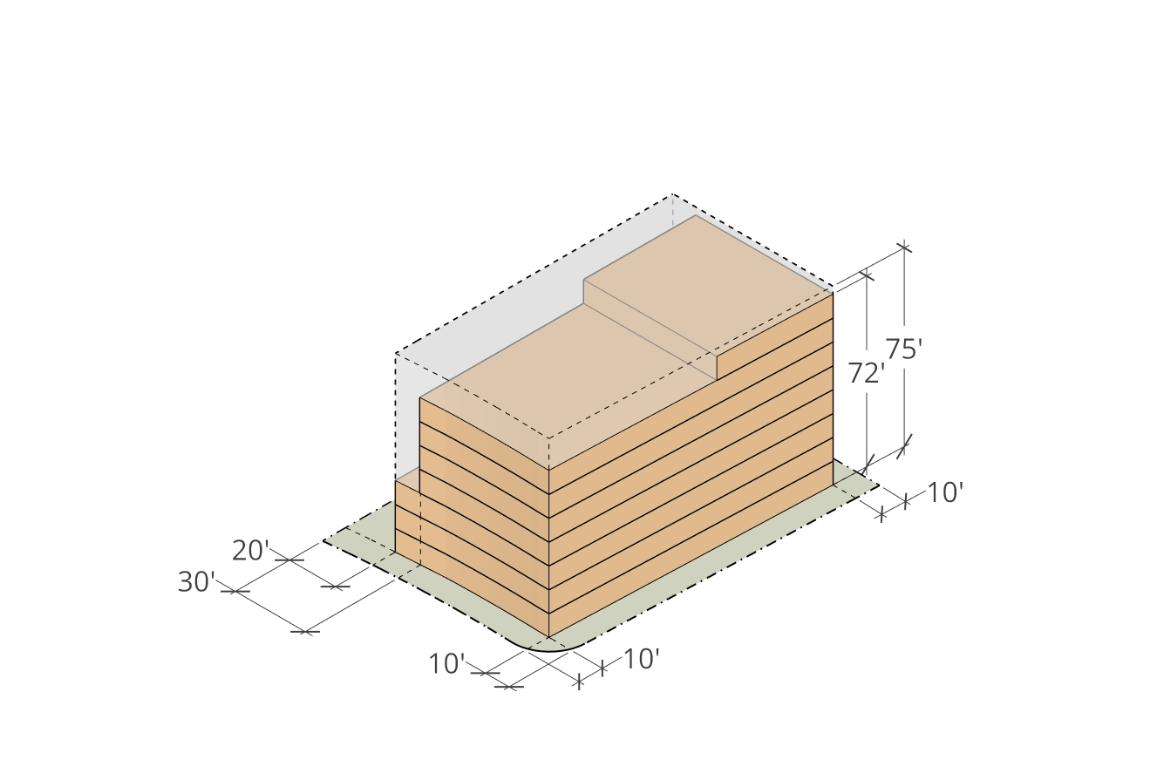
Incentive for Upper Floor Setbacks
Upper-floor setbacks are incentivized through an increased FAR allowance (up to 4.0).
UPDATE IMAGE
El Camino
Real
El Camino
Real
R-1B Lot
R-1B Lot
Valparaiso Ave
Valparaiso Ave
Victoria Ave
Victoria Ave
3.5 FAR
4.0 FAR

Slide 28
Development Considerations
What is more Important?
Setbacks?
Building Height?
FAR?

Slide 29
Other Development Issues
Largely Based on existing RM-40 Standards
Privacy and Screening:
Balconies
Roof decks
Common Open Space
Landscape screening
Utilities and Services:
Accessory Structures
Parking Access
Trash and Recycling
Vehicle Access

Slide 30
Next Steps
Public Workshop
(Tonight)
Planning Commission
Meeting
Jan 28
City Council 1st Reading
Feb 18
City Council 2nd Reading
Mar 18
HCD Review Period
(90 Days)
Ordinance in Place
Jul 1

Slide 31
Pause for discussion
Notes:
It is my understanding that when the Lindenwood subdivision was originally subdivided, property owners were provided the opportunity to select which property line would be considered the front property line for the purposes of development. In this case, the original building permit for the main construction identified Laburnum Road as the front property line , where in other properties identified a wider frontage to be selected and considered the front. AMC Chapter 16.08.100 on Front Lot Lines:
The front lot line is the boundary of a lot whose narrowest portion abuts a public street or access… except where a different front has been previously officially designated or recognized by the Town.
In this case, the narrower lot line, Laburnum Road has long been previously recognized as the front lot line for the property, and therefore, this designation continues with the new development… And with that foundation, we are recommending denial for the proposed project.

Slide 32
Thank you
Notes:
It is my understanding that when the Lindenwood subdivision was originally subdivided, property owners were provided the opportunity to select which property line would be considered the front property line for the purposes of development. In this case, the original building permit for the main construction identified Laburnum Road as the front property line , where in other properties identified a wider frontage to be selected and considered the front. AMC Chapter 16.08.100 on Front Lot Lines:
The front lot line is the boundary of a lot whose narrowest portion abuts a public street or access… except where a different front has been previously officially designated or recognized by the Town.
In this case, the narrower lot line, Laburnum Road has long been previously recognized as the front lot line for the property, and therefore, this designation continues with the new development… And with that foundation, we are recommending denial for the proposed project.

